Slide 1
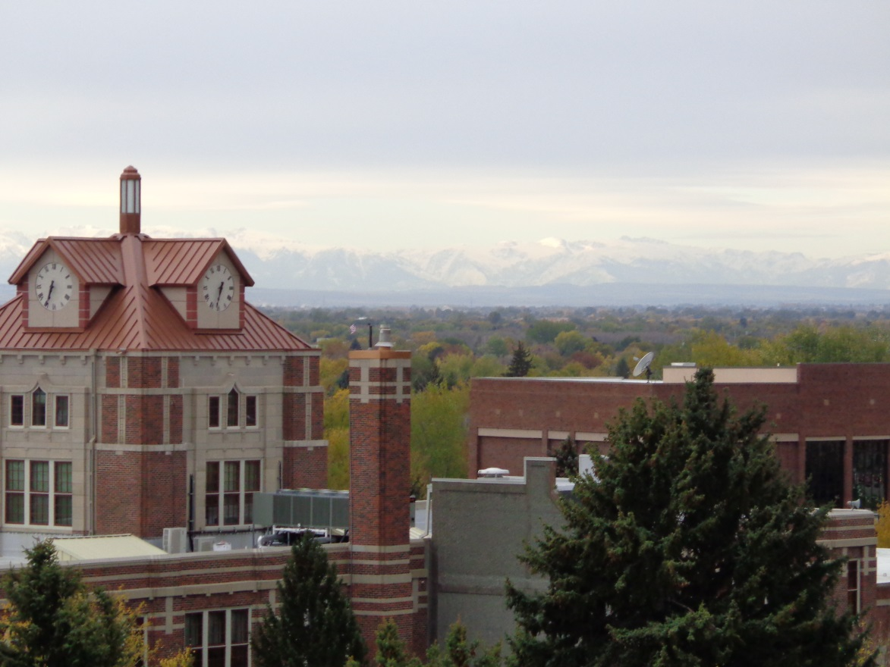
FACILITIES SERVICES
New Employee Orientation
Notes:
Good morning (Good Afternoon) My name is Sam Levis and I work in Facilities services. I am here today to provide you with a basic understanding of the makeup and operations of Facilities Services . Please feel free to ask questions at any time during the presentation.

Slide 2
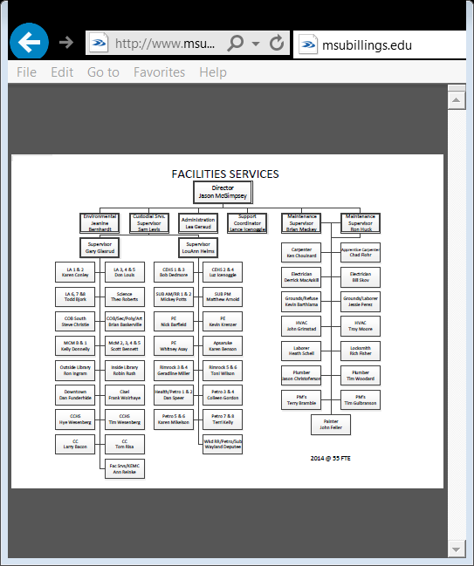
Function of Facilities Services
  Facilities Services has 55 full time employees who are responsible for all Campus Construction Projects, Architectural and Engineering Services, Grounds, Repair and Maintenance, Custodial, and Temperature Control in 26 buildings encompassing approximately 1.5 million square feet in three geographically separate locations.
    Main Campus
    City College
    Downtown Campus
Notes:
Facilities Services utilizes skilled tradesmen and laborers to maintain all MSUB buildings. Routine and periodic system inspections are conducted by Facilities Services Tradesmen. Specialized inspections and maintenance such as elevators servicing and fire safety systems are completed by contractors.

Slide 3
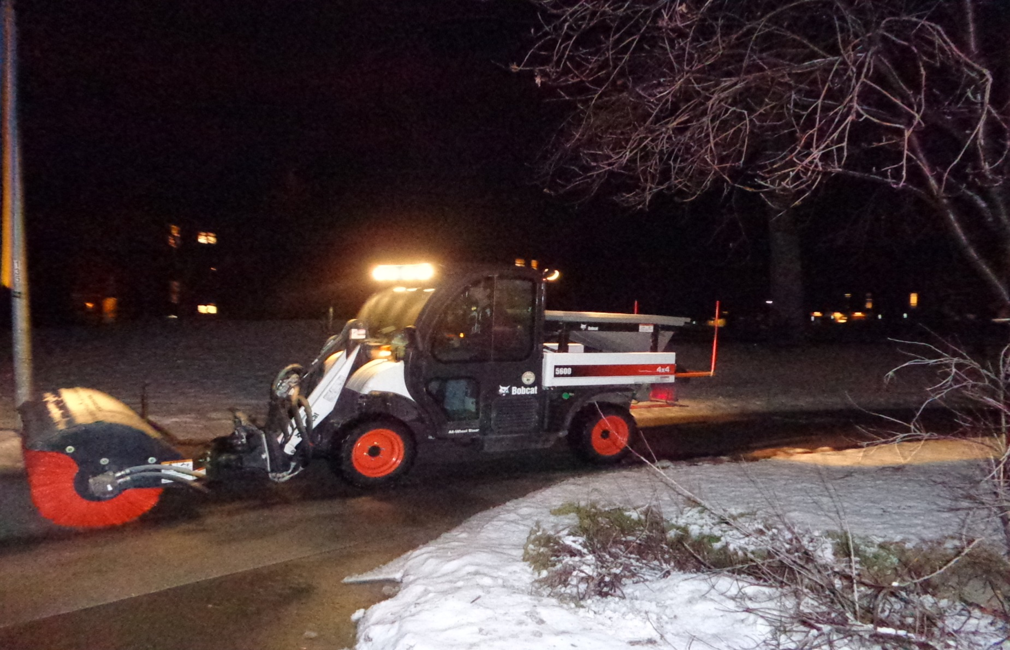
Grounds
  Responsible for maintaining appearance of campus landscape and outdoor areas including Trash Removal.
    Irrigation, fertilization, and Mowing Services are Contracted
    Arborist Services are Contracted
    All other work is performed by In-House personnel
Notes:
Grounds personnel empty all outside trash receptacles, water flower planters, trim hedges and shrubs, maintain water features, and perform snow removal operations.

Slide 4
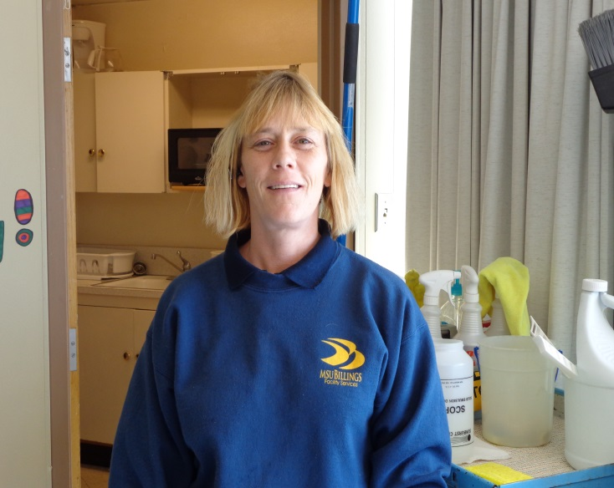
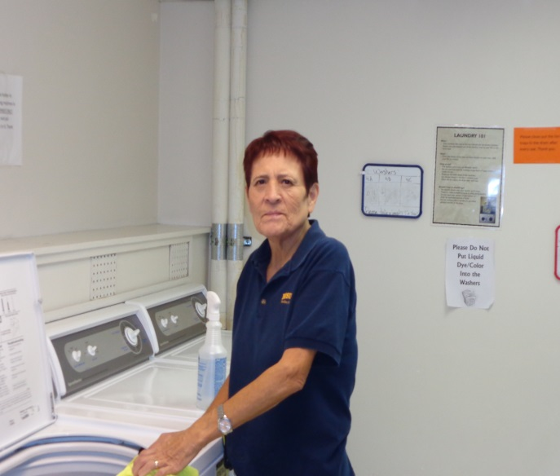
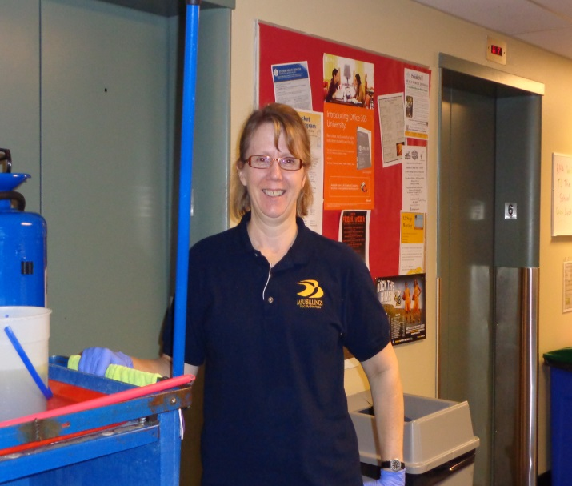
Custodial
  Responsible for appearance and cleanliness of all indoor areas except labs.
    Cleaning Standards have been established in accordance with the Association of Physical Plant Administrators (APPA) guidelines.
    Each Custodian is assigned a specific work area.
    All areas are routinely checked for compliance.
    Requests for special cleaning such as out of cycle carpet cleaning or cleaning offices when there is a change in personnel may be submitted to the area supervisor or the Custodial Services Supervisor.
Notes:
Thirty two custodians are assigned specific work areas in one or more buildings. Each custodian is provided a cleaning schedule to determine the type and frequency of cleaning performed in a specific area. Cleaning is monitored by two supervisors who conduct periodic inspections to assure quality control. Project cleaning such as stripping and waxing floors or extracting carpets is primarily conducted during summer months or over Christmas break. “Green” cleaning products and process are used wherever possible. These are less hazardous to the custodian, customer, and the environment.

Slide 5
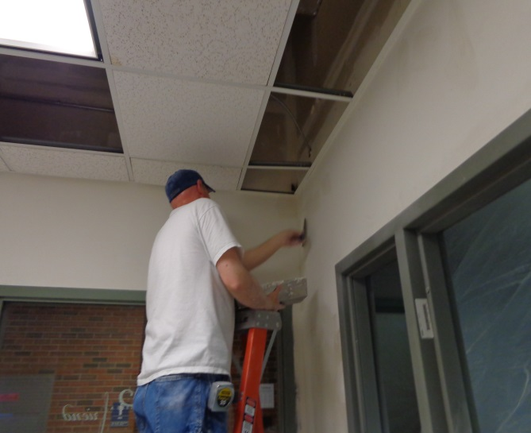
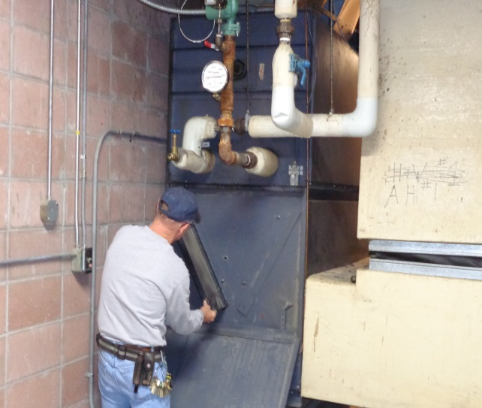
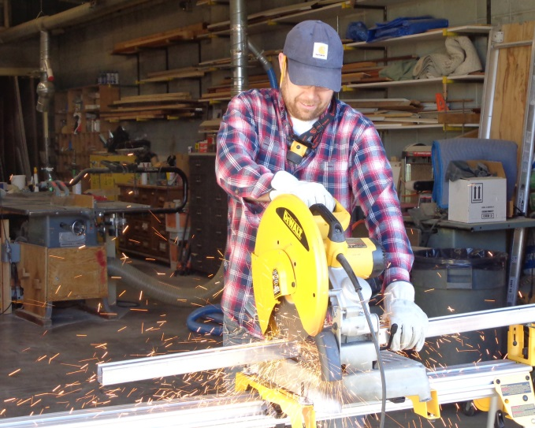
Trades
  Includes; Electricians, Laborers, Plumbers, Painter, Carpenters, Locksmith, Heating, Ventilation, and Air Conditioning (HVAC), and Preventative Maintenance.
  Professional Tradesmen are responsible for upkeep, maintenance, and repair of campus infrastructure.
Notes:
Facilities Services has two electricians, two plumbers, two carpenters, two HVAC personnel, one locksmith and one painter. When major renovations or repairs are necessary, contractors are used to complete the projects or assist our trades personnel. Tradesmen are also responsible for snow removal operations including plowing parking lots and power brooming sidewalks.

Slide 6
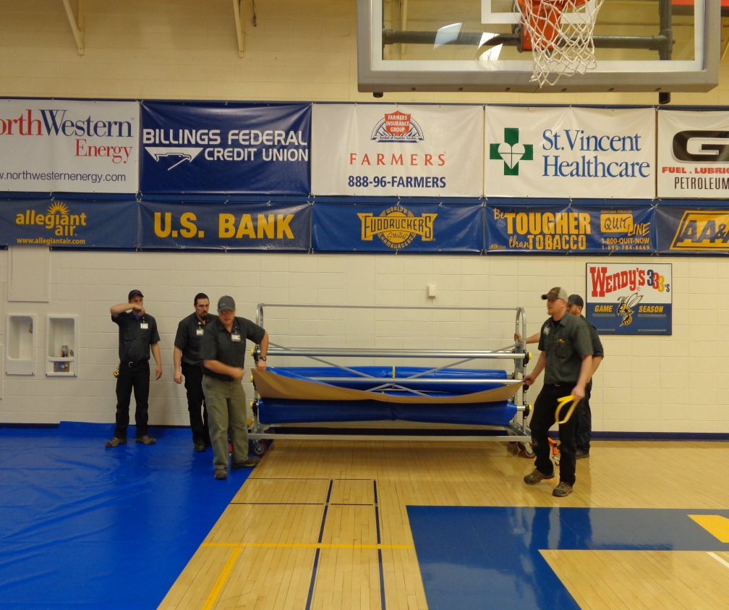
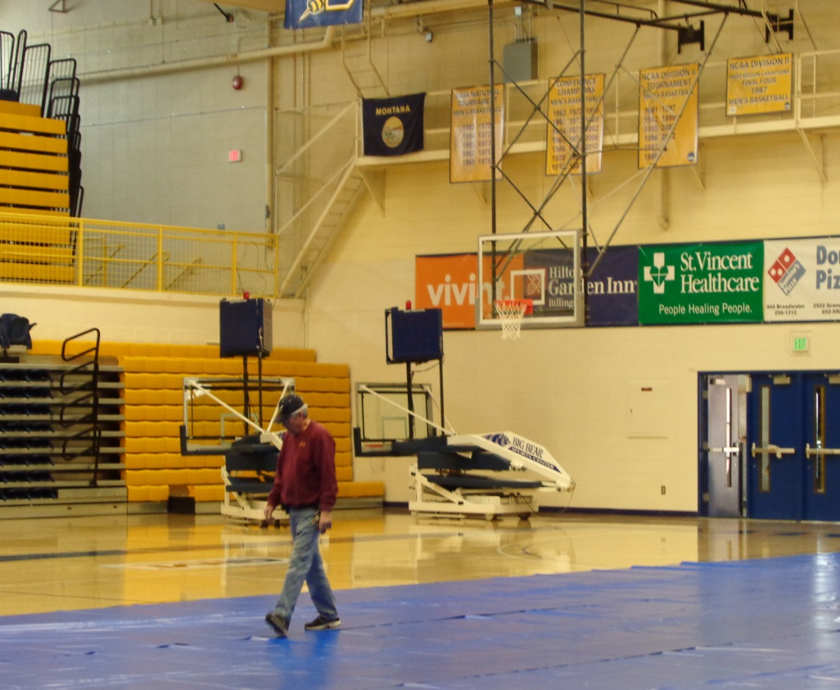
Laborers
  Responsible for moving furniture and equipment, set-up and tear down for special events, delivering supplies and conducting preventative maintenance on equipment and systems. Laborers also are responsible for assisting other trades as needed on construction projects.
Notes:
Two laborers perform preventative maintenance such as filter changes in ventilation systems and lubrication of motors in air handling systems. Other laborers do the heavy lifting on campus such as setting up for special events and moving furniture. Laborers also assist in snow removal operations using snow blowers, power brooms and hand shovels.

Slide 7
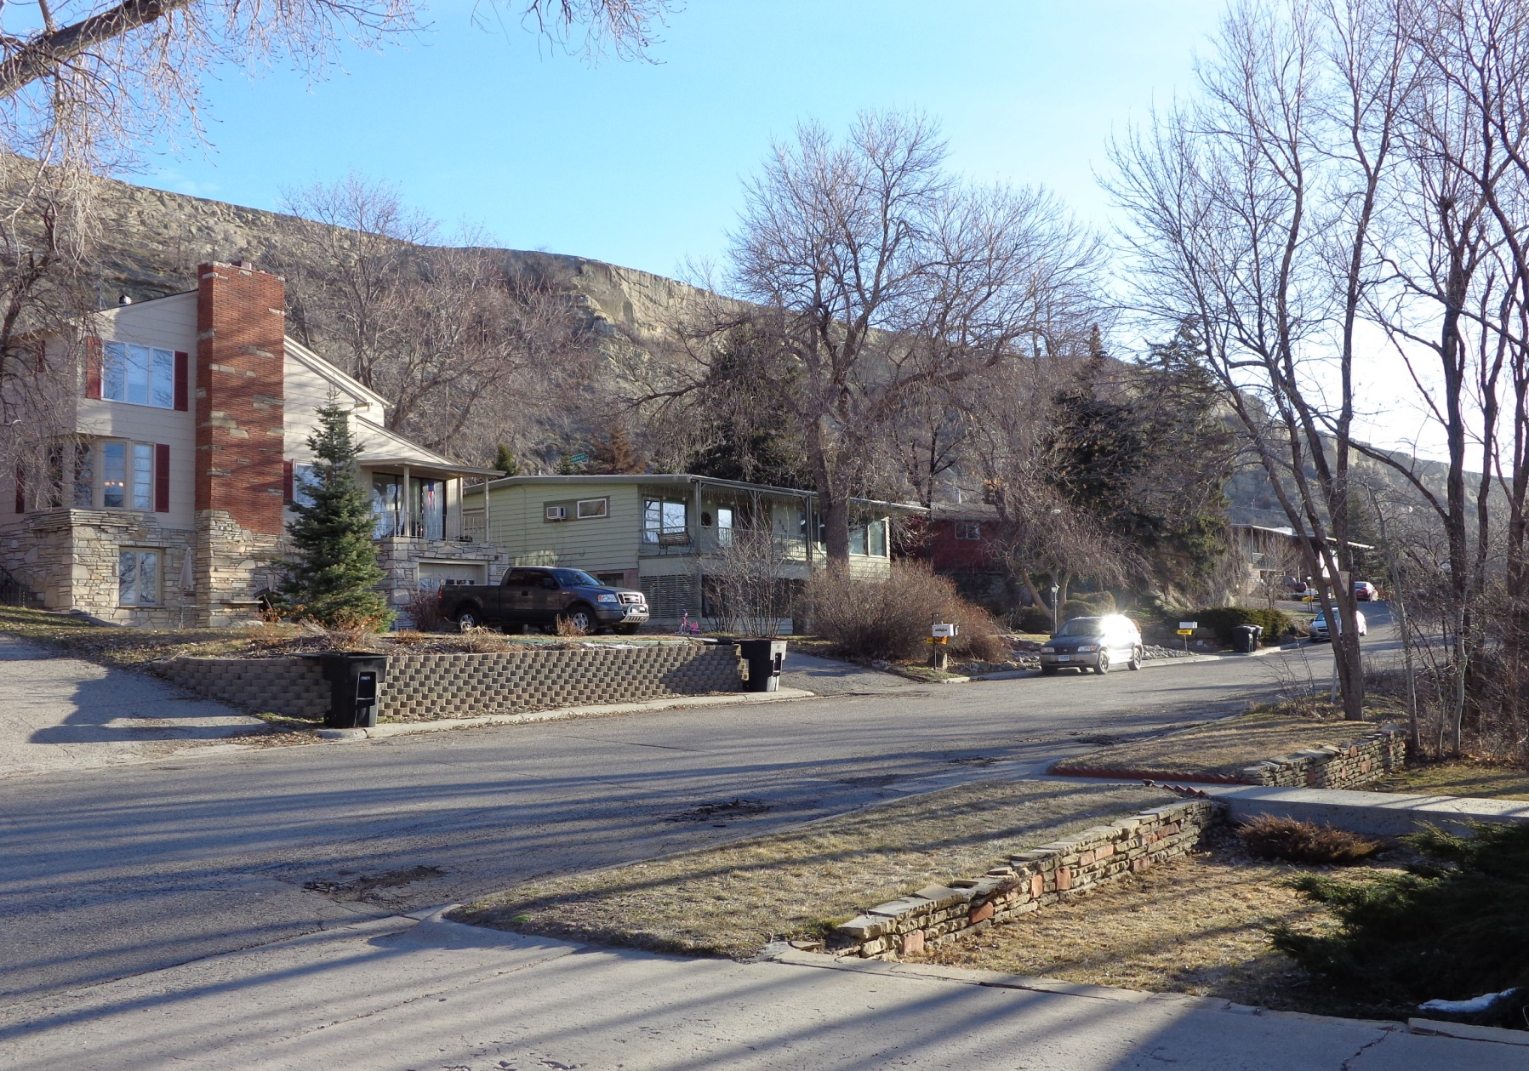
Rental Manager
  Responsible for administering MSU-B rental properties.
Notes:
MSU-Billings has approximately rental properties.

Slide 8
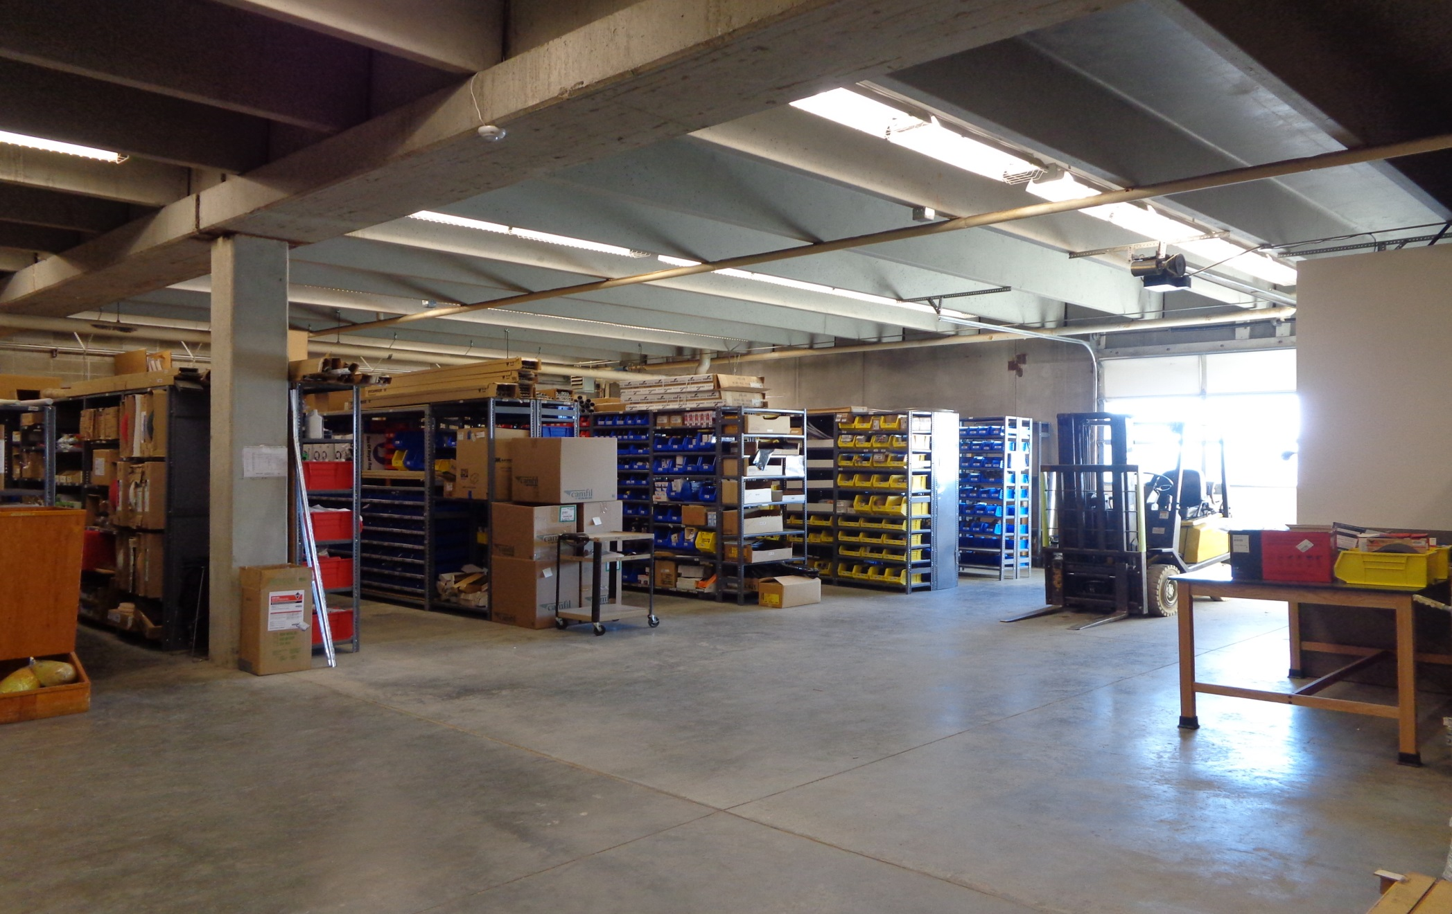
Warehouse
  Acts as Central Delivery Point for shipments arriving on campus and maintains stores for Tradesmen, Laborers, Grounds, and Custodians. Contains various materials, parts, components, etc. utilized for daily operations and construction projects.
Notes:
The Facilities Services warehouse contains parts and equipment utilized by Facilities Services personnel to inspect, repair, and maintain campus infrastructure. Inventory is kept to a minimum by utilizing just in time delivery from parts suppliers and venders.

Slide 9
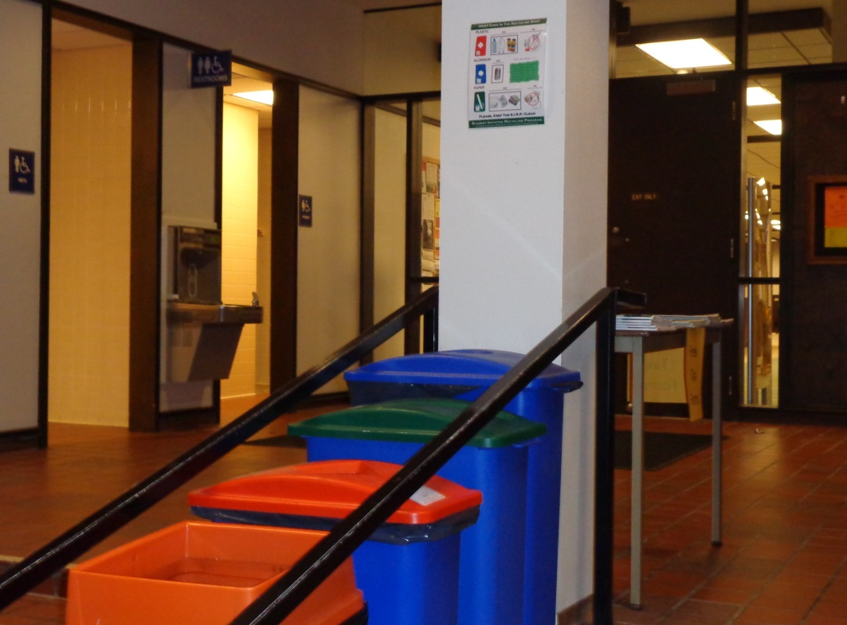
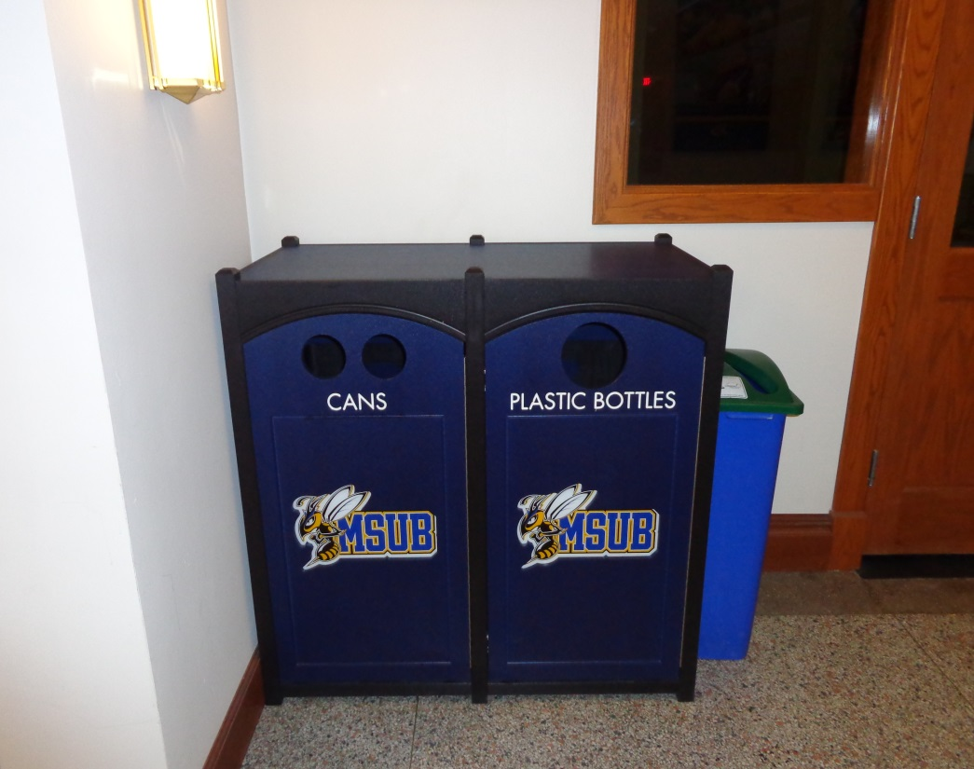
Recycling
  Responsible for oversight of the Recycling Program which includes; metals, aluminum, plastics, paper, and cardboard.
Notes:
Currently a contractor is used to pick-up all recyclables. Facilities Services maintain the recycle containers at all collection points. Recycling is picked up once or twice a week depending upon whether school is in or out of session.

Slide 10
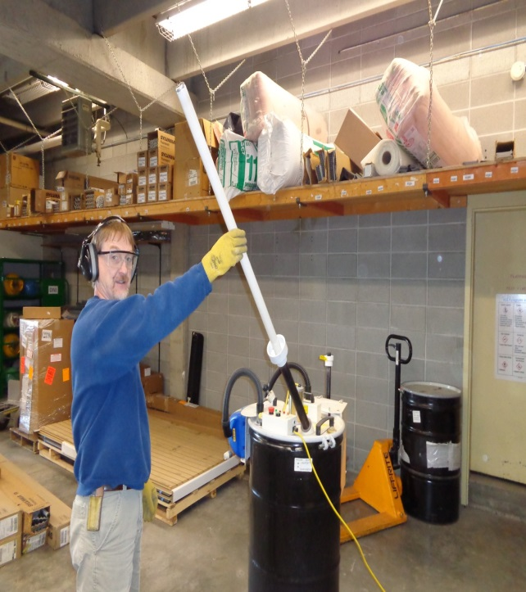
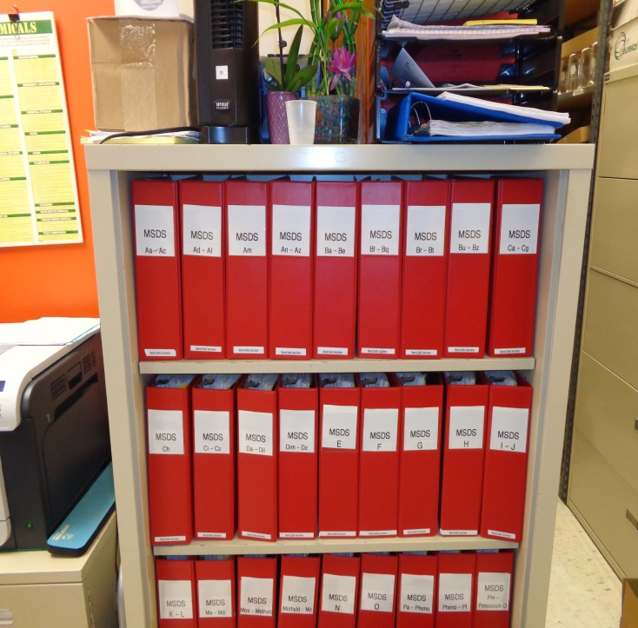
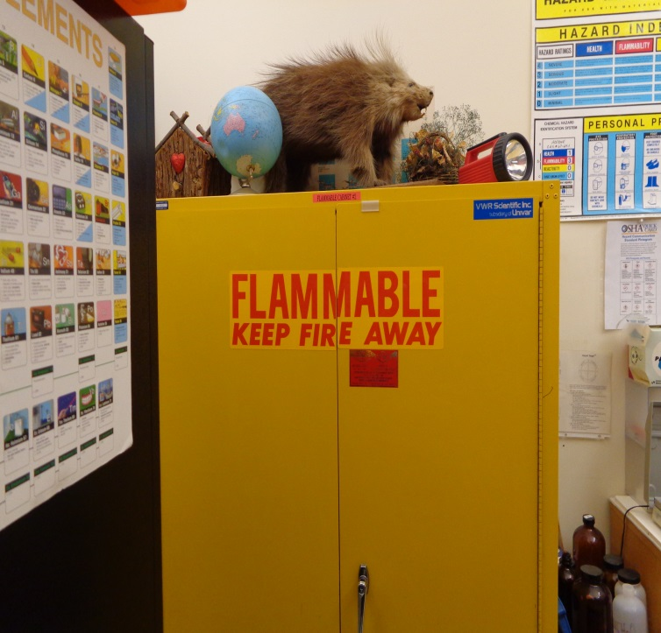
Hazardous waste management
  Ensures hazardous materials on campus are kept to an absolute minimum and are properly stored, used, recycled or properly disposed.
Notes:
Facilities Services uses specialized equipment to process used fluorescent lamps containing mercury for recycling. The entire lamp; glass, aluminum end caps, and mercury are all recycled. NiCad batteries, Ballast containing PCB’s, HID, High Pressure Sodium, and Metal Halide lamps are also sent to contractors for recycling or disposal.

Slide 11
FACILITIES SERVICES OPERATIONS
  Requests for Service:
    Emergency: Call the Trouble Line at extension 1713. The Trouble Line worker creates a work order.
    Non-Emergency: Submit a work order using Facilities Automated Management Information System (FAMIS).
      Work orders can be submitted by building managers and other key personnel who have been trained in the use of FAMIS.
Notes:
A work order must be generated for all requested work. Examples of emergency work: water leak, power failure, elevator stopped. Trouble line may also be used for “hot” and “cold” calls.

Slide 12
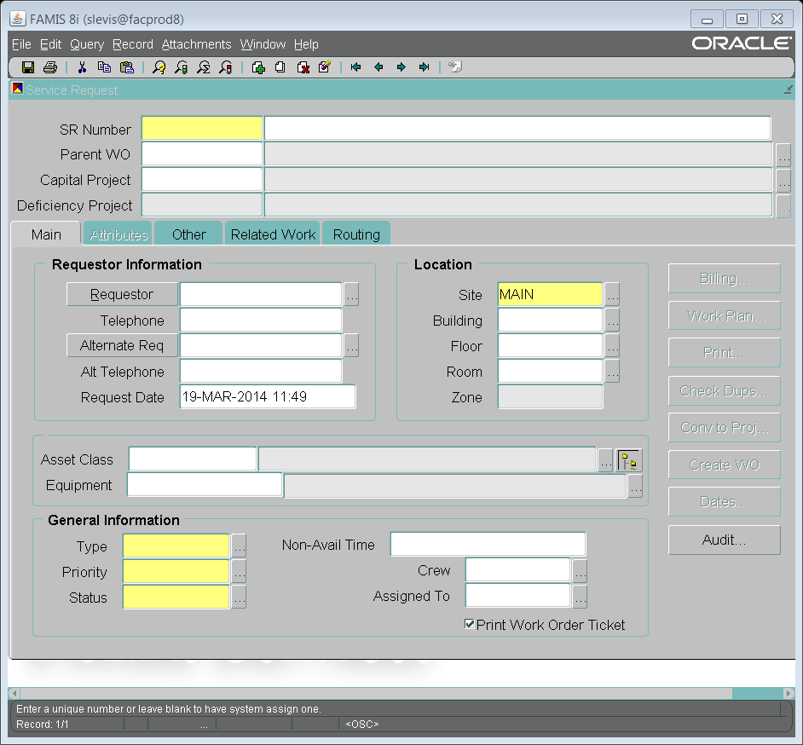
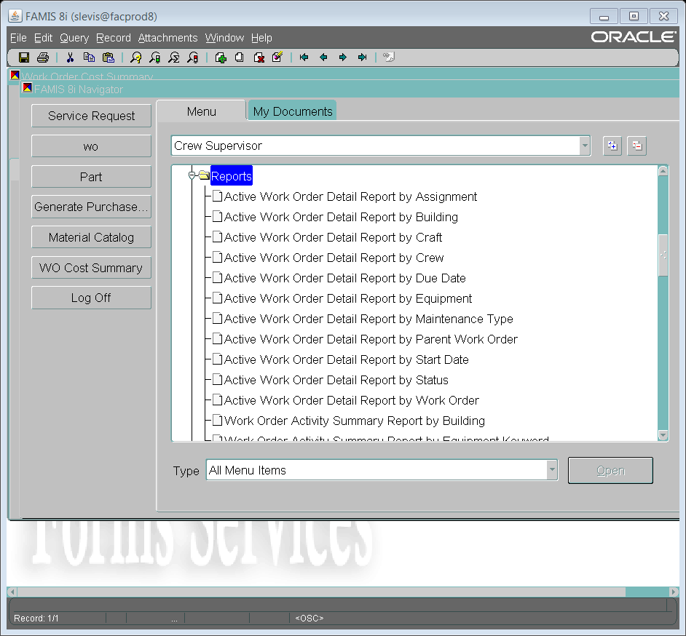
FAMIS Training
  Training is conducted face to face by appointment. Training takes approximately 30 minutes.
  Training is provided to Building Managers and other key personnel identified by Vice Chancellors, Deans of Colleges, Directors, or Department Heads.
Notes:
FAMIS Training is tailored to meet the needs of each individual. Individuals authorized to use FAMIS are assigned a user name and password to access the system.

Slide 13
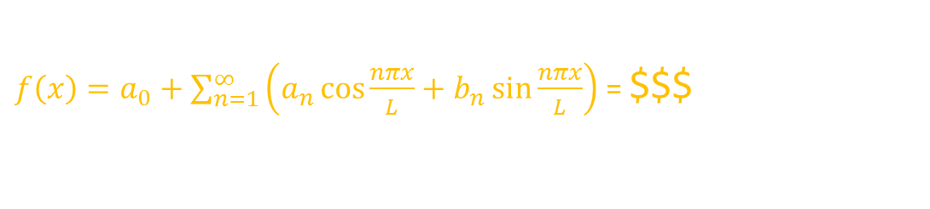
CHARGES AND COSTS
  There is an hourly charge for all work completed by Laborers and Skilled Trades.
    Building Maintenance Index Funds are utilized to cover costs related to items such as; mechanical/ electrical/ plumbing repairs/ building envelope repairs such as doors/windows/floors etc., and preventative maintenance tasks such as filter changes, boiler checks, and emergency systems maintenance.
$f\left(x\right)=a_{0}+\sum_{n=1}^{∞}{\left(a_{n}\cos{\frac{nπx}{L}}+b_{n}\sin{\frac{nπx}{L}}\right)}$ = $$$
Notes:
The next two slides contain important information. Everyone must understand that work performed by Facilities Services is not free. It must be charged to an Index Number or Fund. These slides will explain how that is done.

Slide 14
CHARGES AND COST CONTINUED
    Items such as delivery and installation of Departmental specific materials or equipment, moving furniture or records, painting offices which are not on the maintenance schedule, hanging pictures, etc., are required to be covered by specific departmental indexes. Estimates will be provided upon request and are based on hourly rates to complete the estimate.

Slide 15
SCHEDULING OF WORK
  All work is scheduled on a priority basis.
    Life safety items are ranked priority #1.
    General maintenance items are ranked priority #2.
    Cosmetic items are ranked priority #3.
  Work Orders or Service Requests must be submitted for all work.

Slide 16
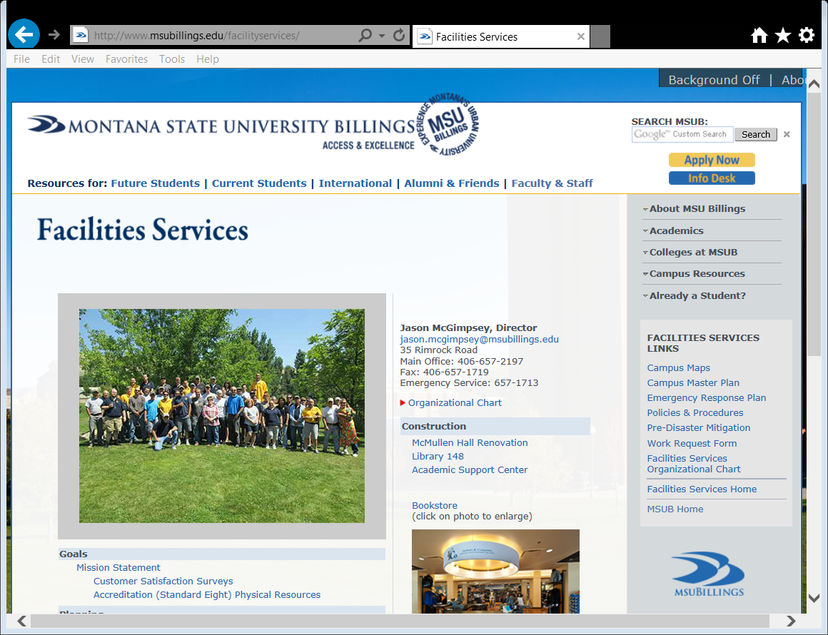
Facilities Services
Questions?
Notes:
That concludes my presentation. If there are any questions, I would be glad to entertain them at this time. Our web page also contains some frequently asked questions and other information you might find helpful.

