Slide 1

Business Services
Presented by Barb Shafer
& Jill Brown

Slide 2
Staff
Student Accounts
Mike Morgan 657-1711
Renee Haefer 657-1707
Misty Shelato 657-1709
System Analyst
Connie Rohrdanz 657-2138
Parking Services
Tessa Eliason
Account Payable/Travel
Jill Brown 657-2151
Vacant (Travel) 657-2301
Rachel Kramer 657-1706
JoAnn Rhodes 657-1683
Mailroom
Sammy Oxendahl 657-2241
Patrick Eller 657-2241
Barb Shafer Director 657-1710
https://www.msubillings.edu/intranet/boffice/index.htm
Notes:
Meet our staff…

Slide 3
Parking Transition Update
Administration
(Business Services)
Parking Permit Sales
Visitor Permit Sales
Citation Payments & Appeals
Maintenance
(Facility Services)
Lot Maintenance
October 16th
Security
(University Police)
Security & Citation Enforcement

Slide 4
Purchasing & Delegation Authority
Total Contract Value (TCV)
All possible renewals
Maintenance/Warranty
Etc.
Notes:
When determining if your department has the authority to purchase and /or funding available the TCV must be calculated.
All possible expenses with a purchase need to be identified prior to issuing a purchase order.
TCV* = Total Contract Value
The total contract value is the initial contract period, plus any options to renew, or the total potential purchase price of an item.
This includes shipping, handling, warranties, maintenance & support, convenience fees, reimbursable expenses, in short – ANY cost that the University will incur throughout the length of the contract
Total Contract Value is used to determine the proper procurement method.

Slide 5
Department Purchases
Purchases up to $10,000
Office Supplies
Equipment including shipping, maintenance, etc.
Etc.
Notes:
Departments are authorized to make purchases up to $10,000 without involvement of Purchasing.
A department should complete price checks for the best value of an item while doing research.
All TCV purchases over $10,000 must be run through the University Purchasing Office.
Departments are encouraged to use their Pcards when it is within their delegated authority.
Departments must follow all IT Approvals and Data Governance approvals.

Slide 6
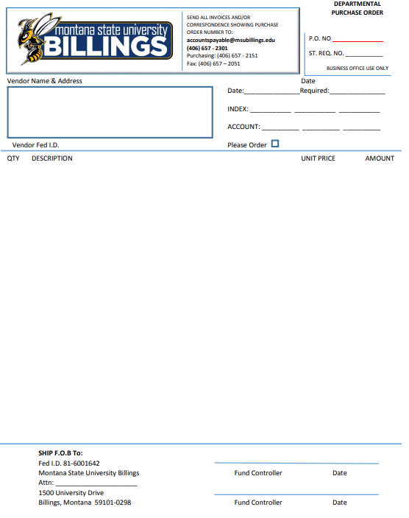
Department Purchase Order
Department Purchases over $10k
Routes to Purchasing
Notes:
The departments are responsible for submitting the DPO to Purchasing with any documentation.
Purchasing will assist in the proper process to complete the order.
The DPO helps purchasing determine the appropriate procedures and verify funding source.
Proper documentation can be Quotes, Sole Source, etc.

Slide 7
Informal Bids
$10,000 - $100,000
Required to be processed through Purchasing
Notes:
If a department is looking to purchase or contract above $10k in either services or equipment/furniture/etc.
A DPO is required including any quotes or additional research the department has gone through. These must be attached to a Departmental Purchase Order and submitted to the Purchasing department for review and to create a formal Purchase Order.
Departments can shop around and obtain quotes but the MSUB Purchasing agent is responsible for submitting a Purchase Order for these items.

Slide 8
Formal Bids
$100,000 +
Requires Purchasing Department to process the appropriate
IFB “Information for Bid”
RFP “ Request for Proposal”
Notes:
Competitive bidding can be in two forms.
IFB – Information for Bid – These are awarded to the lowest bidder, typically used for Equipment/supplies etc.
RFP – Request for Proposal – These are awarded to the most responsive, responsible bidder off a point scoring committee. Typically used for service

Slide 9
IT Approvals & Data Governance Council
Contact the IT department before you buy any software or hardware.
IT will review all contractual agreements for security and legal considerations.
IT will be able to guarantee compatibility with our systems.
IT may be able to save you money!
We may already own something similar.
When you need help, you’ll call IT. We need to be able to support the software/hardware.
IT is required by policy to shut down any system that has an adverse impact on another system.
https://www.msubillings.edu/intranet/data-governance-council/
Notes:
IT must approve all HARDWARE, SOFTWARE, AND WEB SERVICES
Please be sure to involve IT in any research or requests prior to submitting a DPO.
Any Purchase that will result in transfer of data must be routed through the approval of the Data Governance Council, please view the link for additional information.
Starting the approval step should be done in the learning stages of your purchase before a DPO is created or a purchase is made.

Slide 10
Contracted Agreements
https://www.msubillings.edu/intranet/boffice/forms.htm
General Services Agreement
Notes:
The General Services agreement is used for any agreements under $10k with guest speakers or small contracts with individuals, it has been vetted by legal and does not need additional review.
This form is only available in DocuSign. The department starts the form and it will route to the individual and then to the VCAF for signature.
Please remember that the VCAF must sign all agreements for the University. Department Deans/Director/etc must never solely sign an agreement binding the University.
Most agreements will fall within the general services agreement.
Pease give us a call if you have questions .

Slide 11
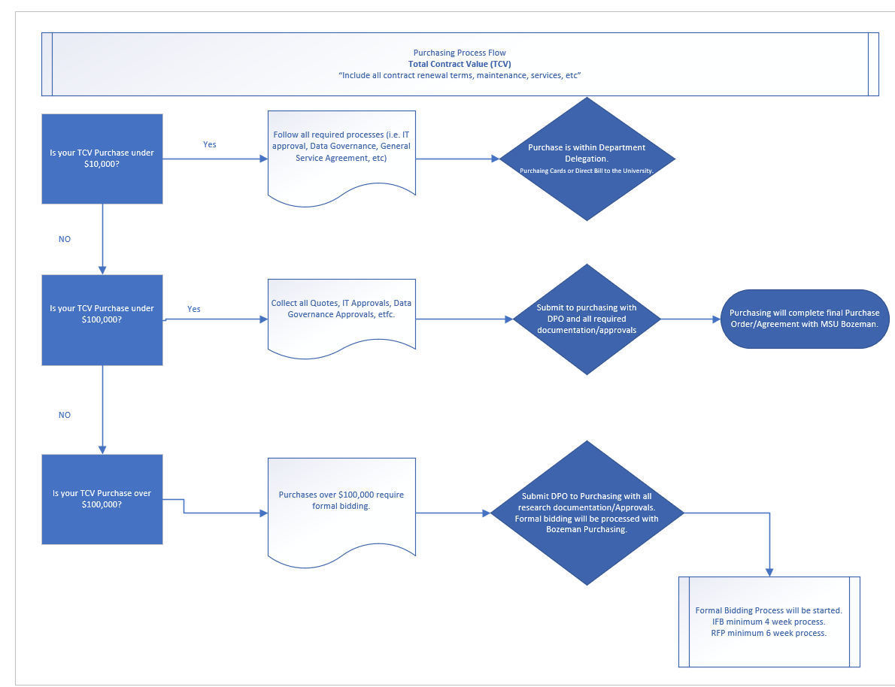
Notes:
Under $10k within your department delegation, but make sure to shop around.
Under $100k informal bidding, process through Purchasing.
Over $100k formal bidding, process through Purchasing with IFB or RFP.

Slide 12
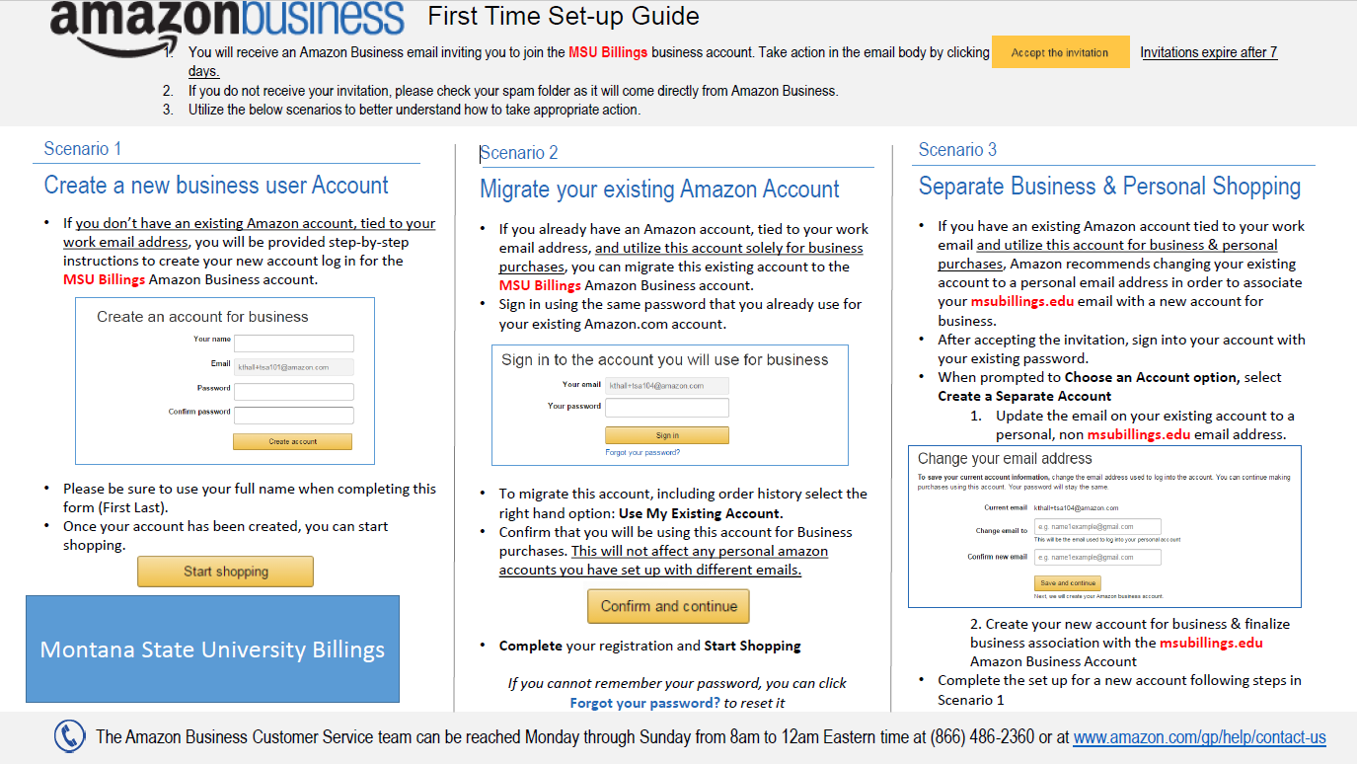
Amazon Business
Notes:
Please notify Jill Brown for an invite.
MSU Billings Amazon Business is the only allowable amazon option.

Slide 13
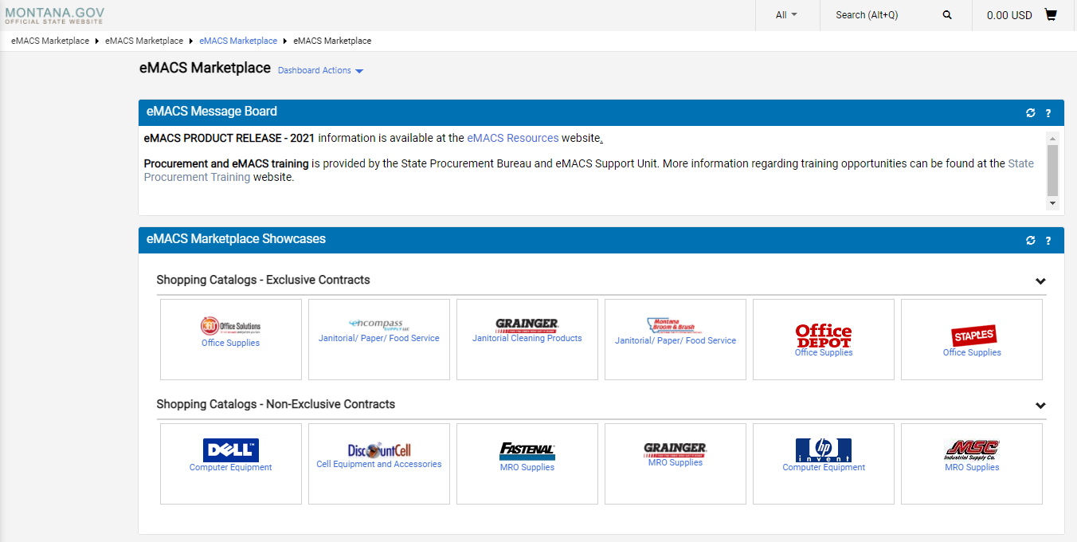
State EMACs program
Notes:
EMACS is the official state of MT marketplace – However, MSU is in the process of creating a similar system called SmartBuy MSU which will have many vendor used by MSU campuses. * More to come
All vendors listed already have the state approved contract pricing listed in this system.
To obtain access contact Jill Brown.
Multiple options are available for ordering.
* PCard
* Assigning a cart

Slide 14
Purchasing Card or PCARD
Airfare (required by the state)
Conference Registration & Hotels
Car Rentals
Office Supplies
*** Knowledge of Chrome River is required as a PCard holder.
Notes:
These are typical uses for a University Pcard, please let us know if you are not sure prior to making a purchase.
Per the state policy airfare is required to be paid on the University Pcard.
Purchases should never be split to accommodate a limit. Speak with Purchasing prior for authorization and limit increases.
All Pcard Holders are required to have knowledge of the process in Chrome River, even if a delegate assists.

Slide 15
Item’s that are not allowed!
Travel: Meals (This is part of the travel per diem. )
Tips, gratuities, porter services while traveling
Entertainment
Alcohol or any substance, material or service which violates policy, law or regulations pertaining to MSU-Billings.
Consulting and/or personal services
Personal expenses (briefcase, coffee, aspirin, Kleenex, dry cleaning, etc.)
Cash Advances
Plants, flowers, silk plants for office (Must take up a collection from your office staff to pay for these).
Prescription drugs/controlled substances
Telephones, cell phones, and related equipment
Gasoline
Payments to Sodexo
Payments for Timeshares (i.e. Lodging)
Capital equipment or equipment with trade in.
No computer equipment, software, or related items (You may use the purchasing card for computer supplies (discs, labels, peripherals and etc.)
Any purchase that is prohibited by current MSU-Billings purchasing policies and procedures, www.msubillings.edu/boffice/
*** Non-Allowable Purchases are not limited to this list ***
Notes:
Travel: Meals (This is part of the travel per diem. You get reimbursed at the instate/out of state rates after your return) Please use your purchasing card for conference fees, airline tickets, motel accommodations, car rentals
Gasoline in Personal vehicles is not allowed but gas purchases in a state owned or rental is allowed.
Personal Expenses! Are not allowed, do not use the University Card for personal purchases.
Violation of the policy may result in loss of the Pcard privilege.
**New with B&N taking over the campus bookstore University Pcards will be the preferred method of payment moving forward. However, index charging will still be allowed.

Slide 16
Paying Vendors
Banner Payment Authorization
AKA the “BPA”
Notes:
When completing the BPA most routing is built into the selection of either an Individual or Vendor.
The initiator of the form will be responsible for listing all applicable signers or fund controllers and completing all areas of the BPA.
Please include the appropriate Fund Controllers, routing may be delayed or declined if our office must re-route for appropriate signers or if relevant documentation is missing.

Slide 17
What needs to be included with the BPA??
Invoices
These things are not acceptable:
Work Orders
Statements
Pro-Forma Invoices
Quotes
Missing Receipt Forms
(Missing receipt forms are ONLY allowed with Pcard reports and even then we Cannot over use them)
Other relevant forms
Relevant Travel forms
Purchasing forms, DPO etc.
Hospitality Approval forms – Final Approved
Required for any food purchase
W9
General Services Agreement
Notes:
HF is required for any food purchase over $50, per the BOR policy.
Pro-Forma invoices, work orders, or statements will not be accepted.
W9’s for any new vendors or updates to current vendors.
BPA’s submitted without the relevant documentation will not be paid. Departments are responsible for submitting all required forms with the approval to pay.
Business Services does not receive the final approved copy of the forms, departments must include them with the BPA.
Hospitality Form
General Service Agreement
W9
Etc.

Slide 18
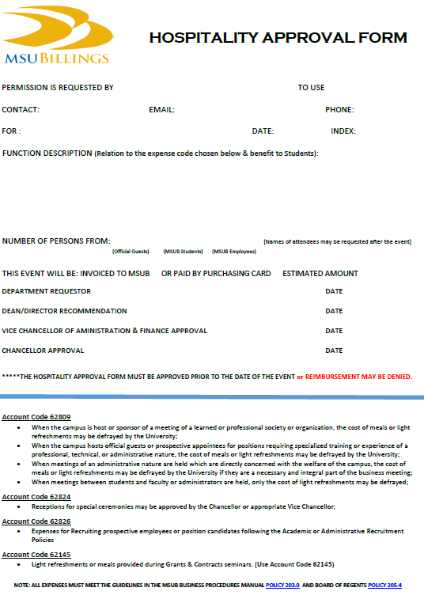
Hospitality
Form
Notes:
The Hospitality form is required before an event takes place.
Be as specific as possible, especially in the FUNCTION DESCRIPTION.
We need to know why and how this event is related to the Expense code chosen on the bottom of the form. Be very specific.
Use the same index on the form that will pay for the event expenses.
if the accounts are different this will cause AP to request another HF from you.
Name(s) of the employees in attendance! Signatures - have two different signatures for the Department Head and Dean/Vice Chancellor/Chancellor (if over $50)
If you submit the HF and your invoice is more than $50 than your estimate we will need a new W9 or and email explanation.
Candidate meals must be all on one form, list specifics in the description to account for all meals, names in attendance, or if multiple areas will pay.

Slide 19
Other important A/P information
W-9 forms
Most recent version from the IRS is dated December 2019.
The form is available on our website at
http://www.msubillings.edu/boffice/Forms.html
If you have a W-9 saved, please make sure it is the most recent version.
Notes:
Vendors must Use the most recent Federal W9 available, however we have created a Substitute W9 for individuals who are not comfortable using the form. Located on the forms page.
W9 is needed for reimbursing new vendor or individual, or to update addresses, etc.
If your not sure it is best to obtain the w9 and attach it with the BPA
W9’s are not needed for university employees who need to be reimbursed.

Slide 20
*** Non-Allowable reimbursements are not limited to this list ***
Don’t forget what is not allowed!
Personal Expenses
Cash
Gifts or Awards
Gift Cards
Flowers
Cards
Parking Decals or Fines
Graduation Regalia or other clothing
Office Treats
Lunches or Snacks for Dept. Meetings
Office Supplies
Coffee, Plates, Napkins, Tissue, etc.
Donations
Drugs or Alcohol
Notes:
Personal Purchases
Cash
Gifts or Awards
Flowers
- Cards
a. Purchased for greetings, birthday, wedding, "going away", funeral, etc
Parking Decal and personal fines
Graduation Regalia and other clothing (non-uniform)
Office treats a. Purchase of treats for office personnel is not an allowable expenditure.
Office Meals
Office Supplies a. Coffee, plates, napkins, tissue, etc. Any items consumed by employees is not allowed.
Donations
a. Donations are not allowed to any organization including charitable organizations.
Drugs and Alcohol
*** Non-Allowable reimbursements are not limited to this list.

Slide 21
Travel
Travel Pre-Approval
Make Reservations
Travel
Chrome River Expense Reports
https://www.msubillings.edu/intranet/boffice/travel.htm
Notes:
Travel Pre-Approvals are in Chrome River for employees
No expenses should be incurred until the pre-approval is complete
Advance minimum is $50 but should not be more than $200, and should only be requested to cover per diem meals.
Make reservations
Hotel
Airfare – Required on the University Pcard
Registrations
All these can be placed on a University PCard after pre-approval is approved.
Keep all receipts (except meal receipts), use CR Snap App.
- Process the CR Expense Report ASAP after travel
Attach all receipts
Questions Contact Business Services
CR Quick Help Guides are available online.

Slide 22
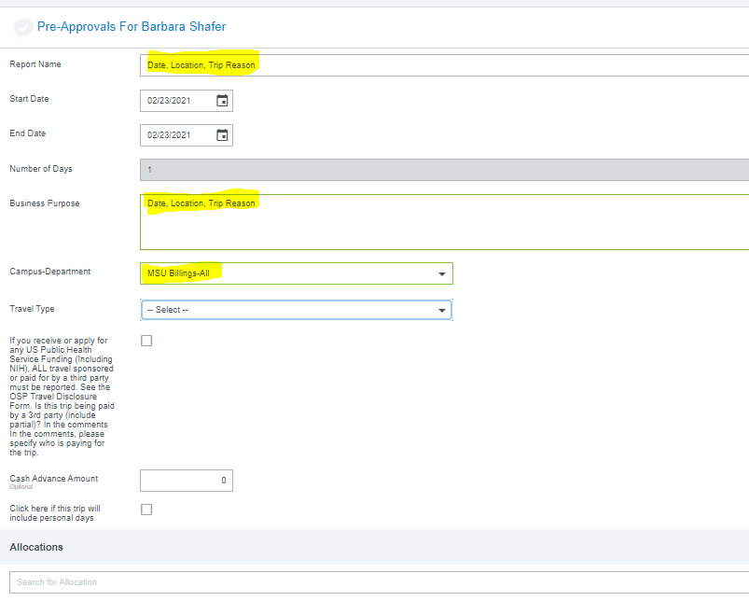
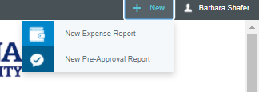
Prior to Traveling
Notes:
Travel pre-approval is required prior to any expenses being incurred.
Student Travel Authorizations are also required prior to travel. These are a DocuSign Form.
Travel Advance request must be received a minimum of 2 weeks before travel or before expenses are incurred
Cash Advance request must be $50 minimum $200 Maximum. A Cash Advance is only used for per diem and can only be requested prior to travel.
- Set up Travel reimbursements as Direct Deposit.

Slide 23
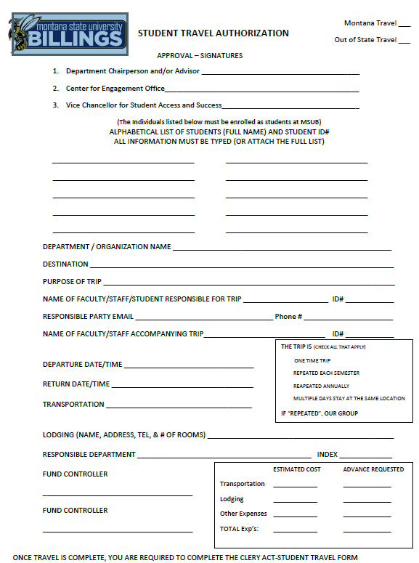
Student Travel Authorizations

Slide 24
Making Reservations
University Pcard
Extra Insurance is allowed for cancellations.
Collect Receipts
Check the travel Policy for changes in High Cost Cities for hotels
Rental Cars
Use the University Pcard for additional Insurance
https://www.msubillings.edu/boffice/rental_car.htm
Trip Insurance is now considered an acceptable expense by the State.
Notes:
Pcards are required to be used for any
Registrations,
Airfare,
Hotels,
Car rentals etc.
Meals are not allowed on the Pcard, per-diem is reimbursed on return
Rental Cars, decline the insurance as we use the University state insurance.
Hotel Reservations – Must be Standard Rate for Montana plus tax. With the exception for the high cost cities.
Big Sky/West Yellowstone
Butte
Glendive/Sidney
Helena
Missoula/Polson/Kalispell

Slide 25

Traveling
Collect all receipts for every expense, except meals
Meals are a set Per Diem
Do not use a Pcard for Meals
Out-of-state Meal Rates as of October 1st
^{Morning $13}
^{Lunch $15}
^{Dinner $26}
Notes:
Use the CR Snap App to collect receipts
or
Keep an envelope for all receipts collected in one spot.
Tips are not an allowable expense.
There is also a Quick Help Guide on loading receipts to CR by email, etc.

Slide 26
Foreign Travel
Travel Pre-Approval
Minimum of 2 weeks prior
And before any expenses occur
Documents required
Participants List and All Emergency Contact Information
Travel Itinerary
Copy of Travelers Passport
Notes:
Pre-Approval must be submitted in CR no later than 2 weeks prior to travel
- Insurance must be added for foreign travel and is an allowable U expense
The University will need to approve that the travel is not into areas with Travel Warning and safety issues.
Emergency Contact Information Names/Phone/Etc is required when registering travel
Jill – Per diem

Slide 27
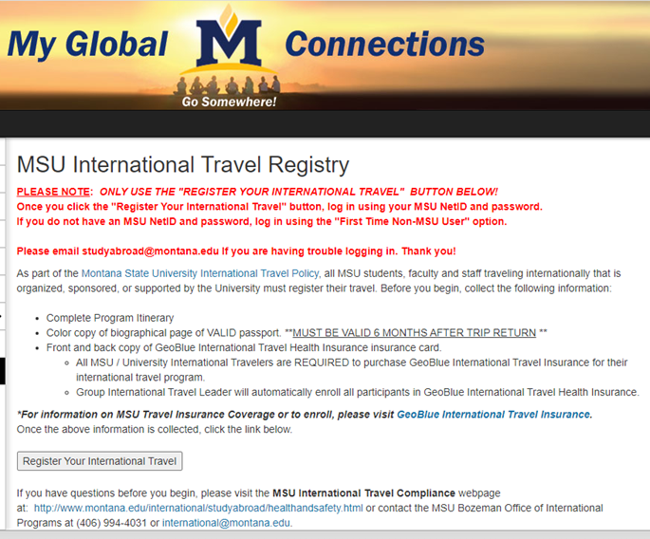
https://montana.studioabroad.com/index.cfm?FuseAction=Security.AngLogin
Notes:
MSU Bozeman does manage the International Travel Registration page.
Purchase of GeoBlue is required for international travel

Slide 28
Policy & Procedures
http://www.msubillings.edu/boffice/Policy%20&%20Procedures.htm
Accounts Payable
Travel
Purchasing
Accounts Receivable
Biz hub (mailroom & printing)
Misc
Relocation
Document retention
Cash Account & Deposit
Raffle Prizes
Recruitment Policy is in the process of being updated
Notes:
Accounts Payable
Campus Credit Cards
Hospitality Form
Payments/Claims
Non-Allowable Expenditures
Travel
Foreign Travel
Travel Authorization
Travel Expense Voucher
** recruitment Policy Changes, min of 2 employees with a candidate, controlled substance language, food prep regulations
Purchasing
Delegated Authority
General Purchasing Guidelines
Department Purchase Order (DPO)
Independent Contractor
IT Procurement Approval Form
Brand Name and/or Sole Source
Purchasing Card Manual
Accounts Receivable
3rd Party Vendors
Cashier/Payments
Holds
Installments
Refund Policy
Safeguarding
Tuition & Fees
Biz Hub
Copy Center
Mail Room
Bulk Mail
Misc.
Relocation Expenses
Document Retention
Cash Account and Deposit
Raffle Prizes

Slide 29
Chrome River
The Travel and Purchasing Card expense management tool
https://www.msubillings.edu/intranet/boffice/chromeriver.htm
Notes:
Chrome River.
Where to find CR links
Where to find CR Help guides
Jill will review these Chrome River Basics
Setting up Delegates and general navigation
Creating a Travel Pre-Approval (Is required prior to travel)
Creating a Travel Expense with a Pre-Approval
Updating items paid in a previous month, etc.
Using the Expense Category Tool
Updating the tile
Reviewing the Report before submitting
Tracking a report or Travel reimbursement
Receipts
Approvals
Setting up ACH for reimbursements

Slide 30
Chrome River Quick Help Guides https://www.msubillings.edu/intranet/boffice/chromeriver.htm
Getting Started
Create a Travel Pre-Approval
Create a Travel Expense Report from Pre-Approval
Create a Mileage Expense (Travel)
Create a Non-Travel Expense Report
Approvals
Approval Reassign
Approvals Via Email
Approval Email not Functioning
Hotel Itemization
Uploading and Attaching Receipts
Use the P-Card Itemization Tile
Recall a Report
Editing Header Information
Dealing with Fraudulent Charges
Personal & Non-Reimbursable Charges (Travel)
Personal & Non-Reimbursable Charges (Non-Travel)
Notes:
These are step-by-step guides to assist with all aspects of CR

Slide 31
Questions
Thank You
Barb Shafer 657-1710
Jill Brown 657-2151
Suggested Future training items
Please email bshafer@msubillings.edu
Notes:
Be sure to let us know what you would like to see being trained on for future trainings.
Let us know if you would like more discussion or training on a personal level. We are happy to assist in making this easier on all ends.
Helping you perform your job is also helping ourselves!

