Slide 1



COVID-19 Virtual Town Hall
Thursday, November 18, 2021

Slide 2
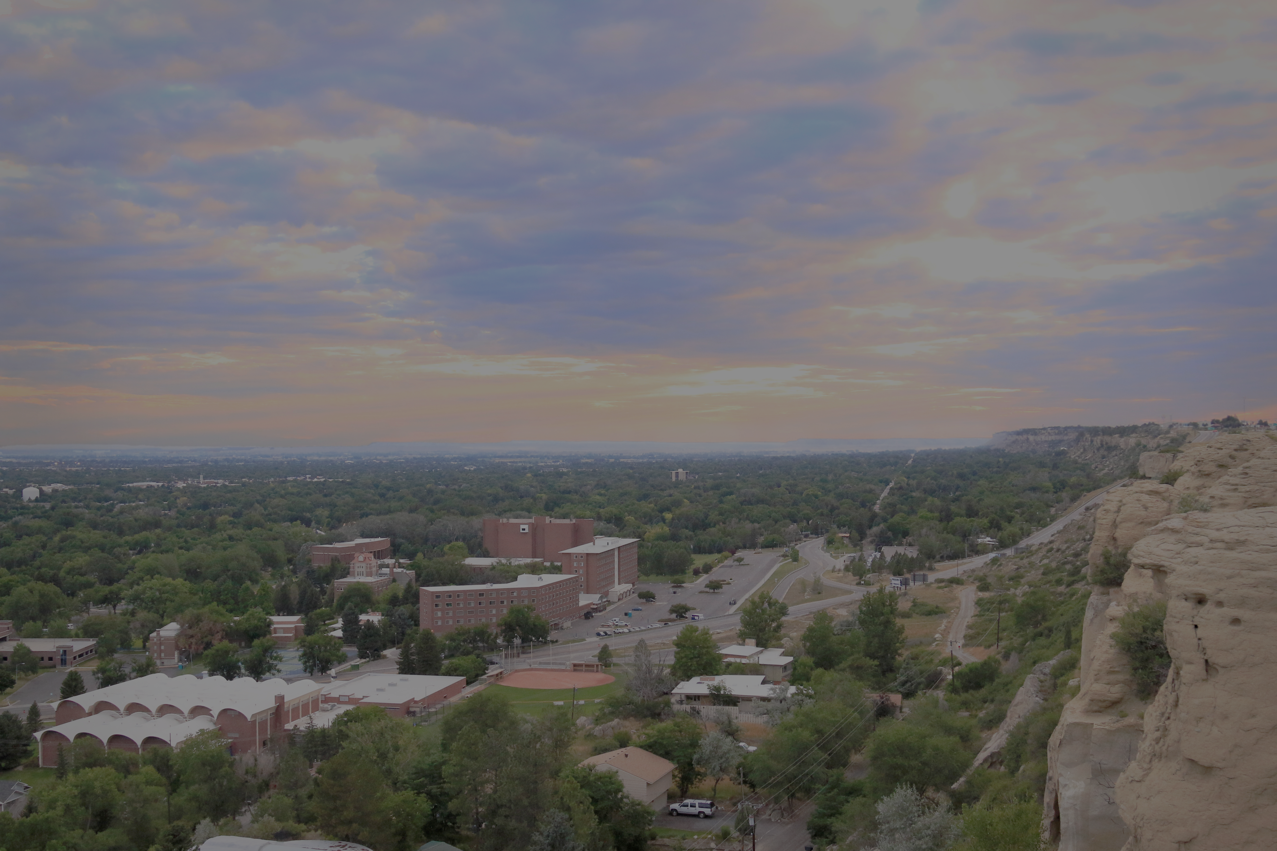
MSUB COVID-19 Town Hall Agenda
COVID-19 data & updates:
Kurt Toenjes, Dean of the College of Health Professions & Science
2. Campus health & safety updates:
Darla Tyler-McSherry, Director of Student Health Services
3. Guest speaker: Prof. Anna Talafuse
4. Q&A

Slide 3

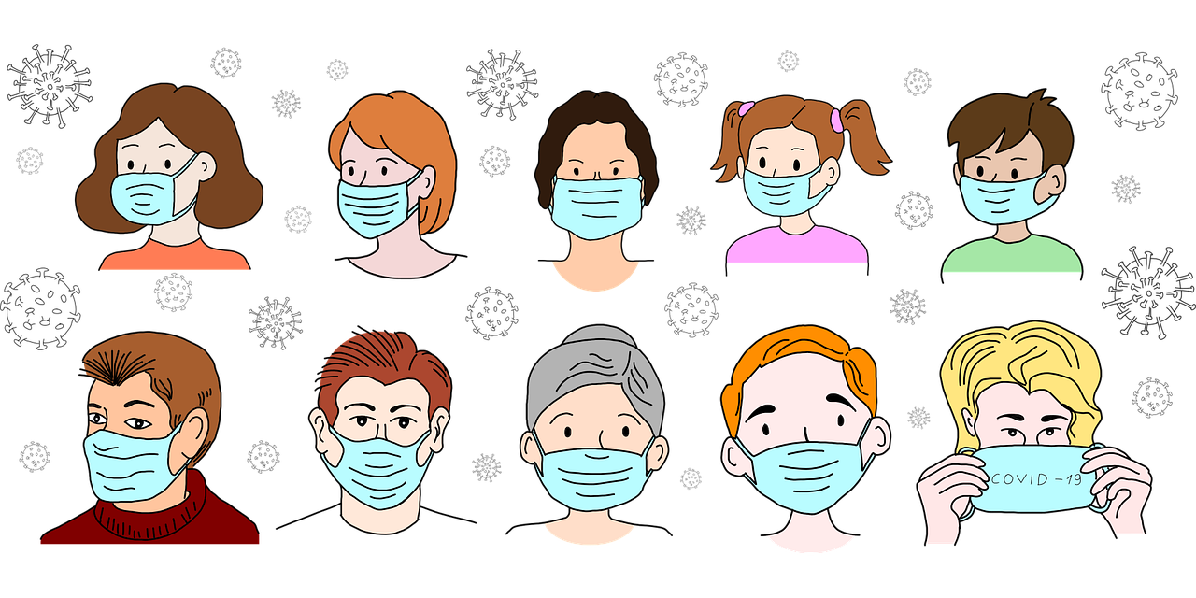
COVID-19 updates
When to return to campus after you’ve recovered from COVID-19?
When to get a COVID-19 test?
Do I need a COVID-19 booster shot?
Why completing the Voluntary COVID-19 Reporting form is vital to our campus health and safety

Slide 4

COVID-19 updates
Staying smart and healthy during the holidays:
Gather outdoors when possible
Virtual holiday events
Increase ventilation in your home and keep gatherings short
Wear face masks
Physically distance six feet or more
Practice good hand hygiene
Stay home when sick, have a fever, upset stomach, overly tired, cough, sniffle, “allergies,” etc.

Slide 5
MSUB COVID-19 Town Hall Agenda
COVID-19 data & updates:
Kurt Toenjes, Dean of the College of Health Professions & Science
2. Campus health & safety updates:
Darla Tyler-McSherry, Director of Student Health Services
3. Guest speaker: Prof. Anna Talafuse
4. Q&A

Slide 6
Campus health & safety updates
MSUB COVID-19 Update
2 in isolation, 8 recommended to quarantine.
None in residence halls
Free COVID-19 testing for students at University campus Student Health Services
M-F 8:00-5:00 call 657-2153 prior to arrival

Slide 7
Campus health & safety updates
Community COVID-19 shots:
Cedar Hall at MetraPark
and RiverStone Health covid.riverstonehealth.org
Community COVID-19 Testing Info on COVID-19 Central Webpage
Students: Get your FREE vaccines before going home for the holiday weekend!
COVID (1st, 2nd, and booster) and Flu vaccines available at both SHS locations

Slide 8

Campus highlight:
Town Pump Gift Card Winners:
Emilee Kidd
Josh Hulgan
Shawna Nichols

Slide 9
MSUB COVID-19 Town Hall Agenda
COVID-19 data & updates:
Kurt Toenjes, Dean of the College of Health Professions & Science
2. Campus health & safety updates:
Darla Tyler-McSherry, Director of Student Health Services
3. Guest speaker: Prof. Anna Talafuse
4. Q&A

Slide 10
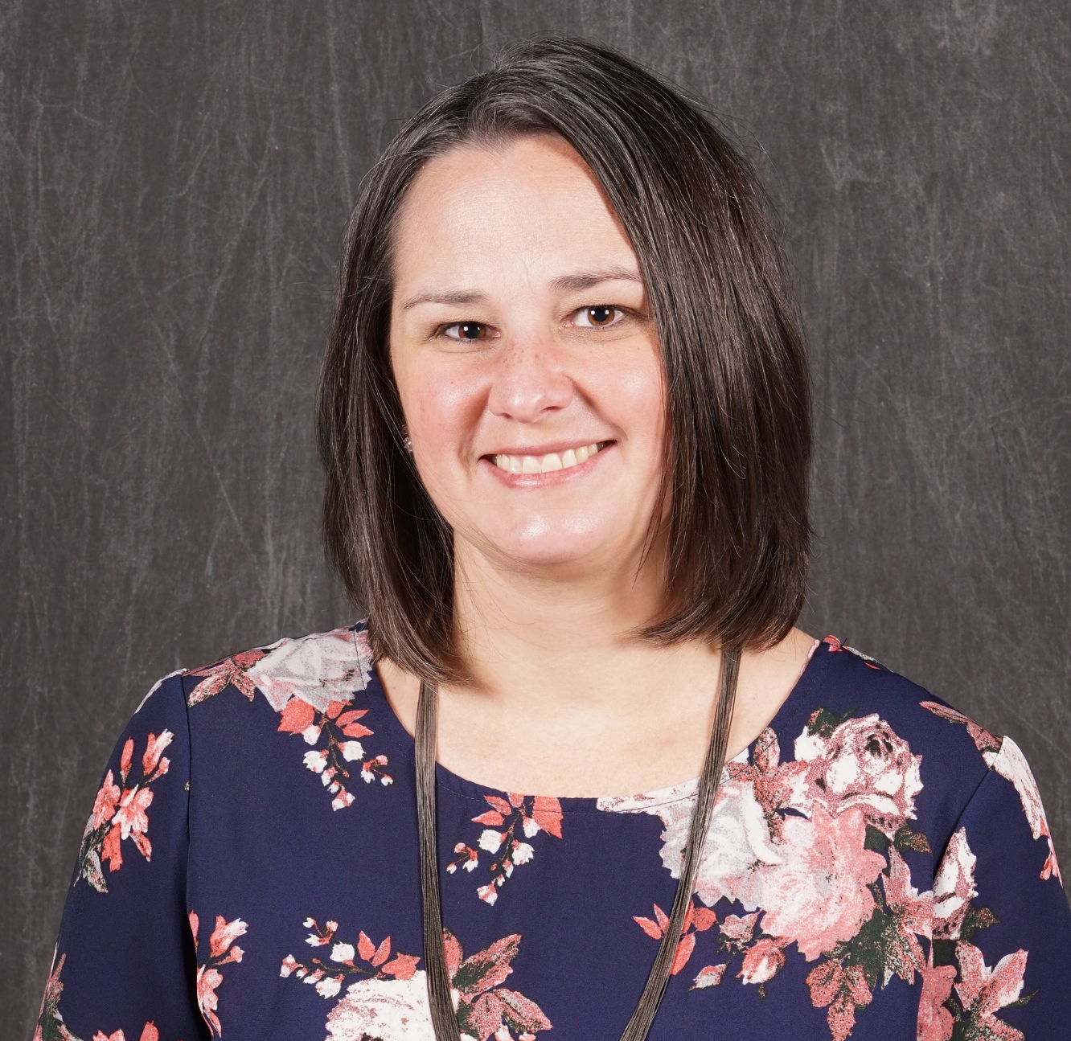
Guest Speaker
Dr. Anna Talafuse
Assistant Professor of Marketing

Slide 11
HyFlex
Allows fully flexible participation for students. Students may choose to participate fully online, fully in-person or a combination of both and may change their participation mode at any time. Synchronous remote participation may be offered but cannot be required.
Learner Choice
Equivalency
Reusability
Accessibility
Must comply with the MSUB Core Principles of Quality for Online Courses. (Course registration codes begin with -70)
(Honea, 2021)

Slide 12
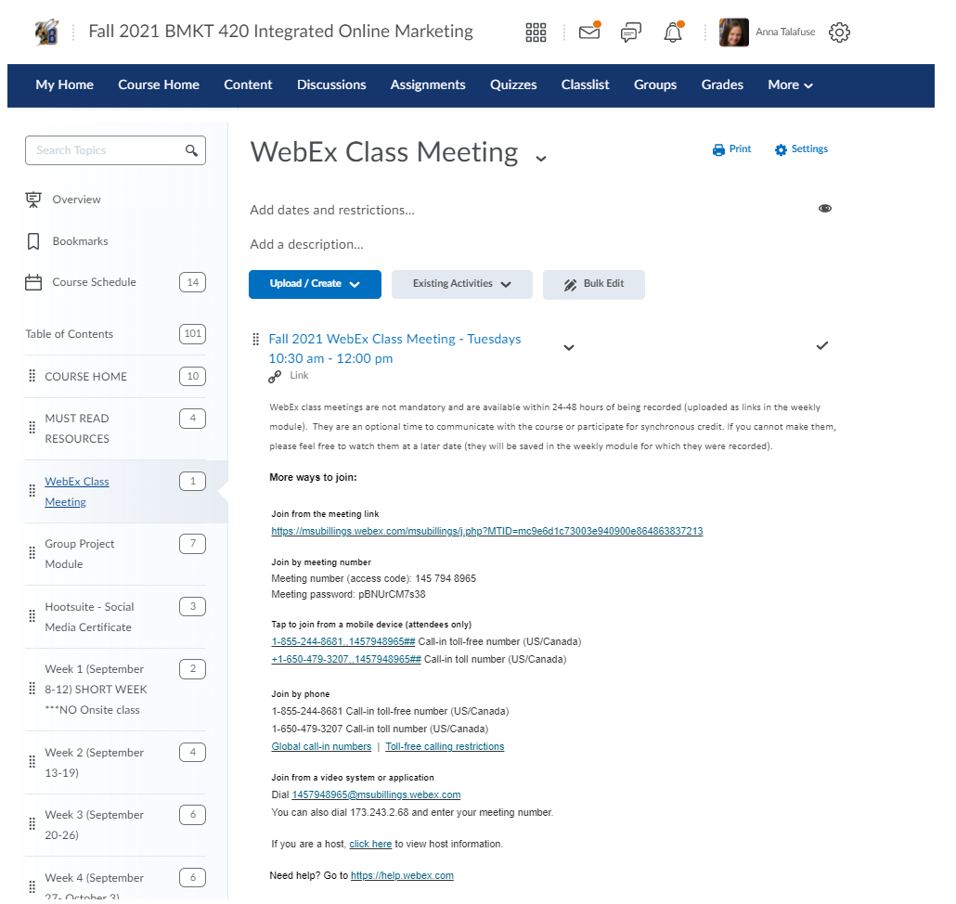
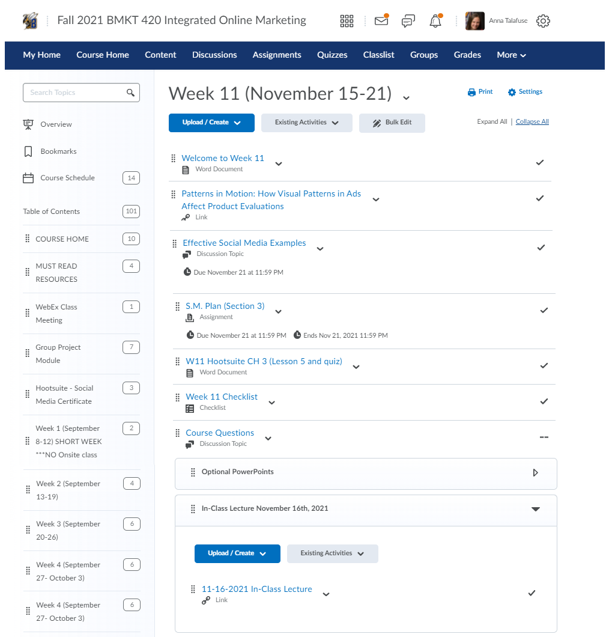
Attending Synchronously
Attending Asynchronously

Slide 13
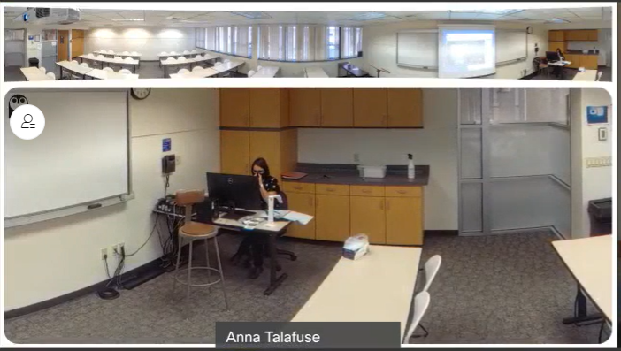
Onsite attendance and Synchronous view

Slide 14

Q&A
Type question in chat box.
If your question is not answered during the town hall, it will be answered via email.

