Slide 1
FINANCIAL SERVICES
PRESENTED BY HEATHER HANNA

Slide 2
FINANCIAL SERVICES STAFF
DIRECTOR: LEANN ANDERSON 657-1634
ACCOUNTING & FINANCIAL REPORTING
HEATHER HANNA 657-1682
NANCY BURTON 657-1681
REBECCA EMTER 657-1631
GINA HERBERT 657-2625
GRANTS & CONTRACTS
BRENDA BRAKKE 657-1679
PAYROLL
JACKIE ELLSBURY 657-1777
RONNA BELL 657-2106
Please visit our homepage: http://www.msubillings.edu/financialservices/

Slide 3
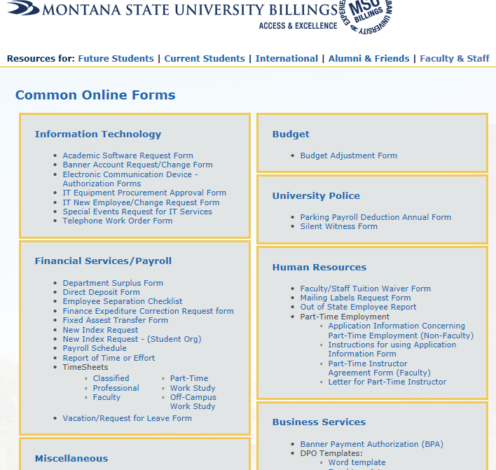
How do I sign up for a Banner Finance account?
Go to our Faculty & Staff Online Forms page: http://www.msubillings.edu/Technology/OnlineForms/
The form is under the Information Technology Section - Banner Account Request/Change Form.

Slide 4
Banner Finance Account cont.

Slide 5
Banner Finance Account cont.

Slide 6
Banner Finance Account cont.

Slide 7
Banner Finance Account cont.

Slide 8
Banner Finance Account cont.

Slide 9
Banner Finance Account cont.
Request Index access
Contact Financial Services for form

Slide 10
Operating Ledger
Balances of revenues and expenses for an Index
Shows revenues and expenses for current fiscal year only
Revenues and expenses increase or decrease cash balance
Also referred to as the Income Statement or P & L Statement
Find Operating Ledger activity in Banner in the FGIBDST form or the Operating Ledger Transaction or Summary report on the Banner Report Web

Slide 11
Index
Shorthand” method of identifying the Fund, Organization and Program
Fund – Shows ownership of cash or fund balance
Organization - Represents a Department or Other Budgetary Unit
Program – Used to classify expenditures by function
01 – Instruction
02 - Organized Research
03 - Public Service
04 - Academic Support
05 - Student Services
06 - Institutional Support
07- Operation and Maintenance of Plant

Slide 12
Types of Indexes
Type Index No. Description
General Operating 61xxxx State Appropriated
Restricted 62xxxx **Usually Grants & Contracts**
Designated 63xxxx Revenue Earning
Auxiliary 64xxxx Revenue Earning

Slide 13
How do I find transactions posted to my Index?
There are a few different ways to find Index activity in Banner:
FGIBDST form in Banner shows Operating Ledger activity or:
Operating Ledger Summary and Operating Ledger Transaction reports on the Banner Report Web
Banner Report Web link:
https://sais.montana.edu/cgi-bin/msu_sb_v3.pl

Slide 14
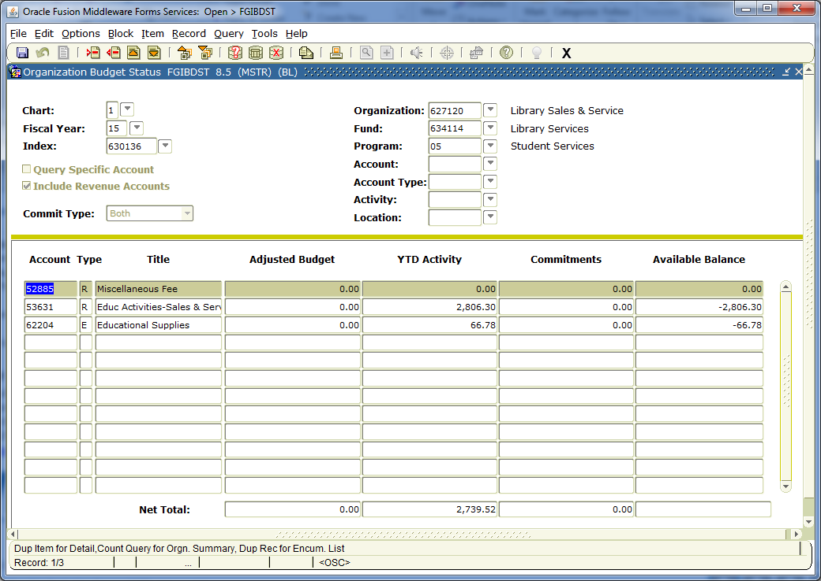
Operating Ledger Activity in FGIBDST
Below is an example of the FGIBDST Banner form for a Designated Index.
Index 630136 is a Designated index.
Fund
Org
Program
There is both revenue and expense activity in this index

Slide 15
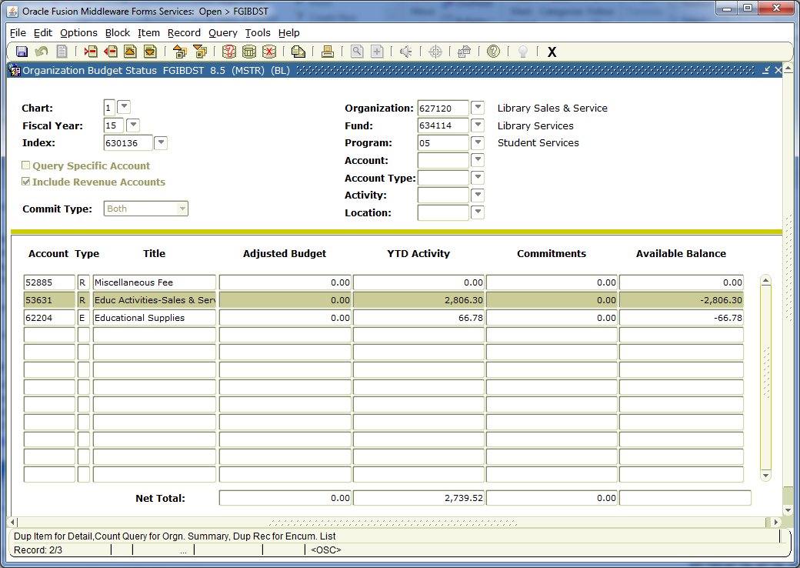
Operating Ledger Activity in FGIBDST (cont.)
To further review a revenue or expense account year-to-date balance, click in the YTD Activity Box of the account line you wish to review. For this example, we will choose account 53631.
Step 1: Go to: “Options”
Step 2: Select: “Transaction Detail Information”
Step 3: <Control><Page Down>

Slide 16
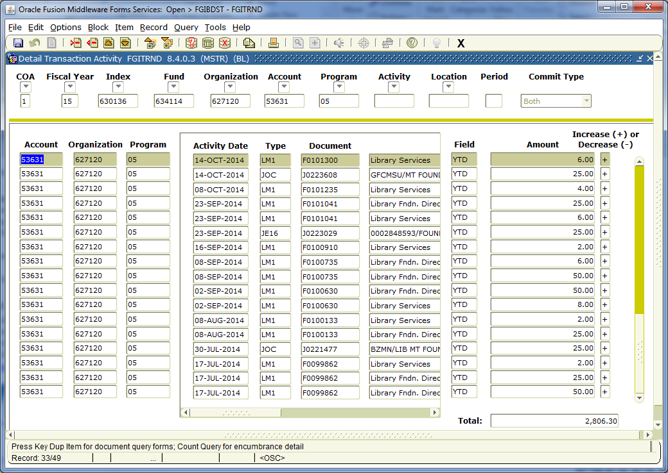
Operating Ledger Activity in FGIBDST (cont.)
In this example, there are several transactions comprising the YTD balance for account 53631.

Slide 17
Operating Ledger Summary Report
Note: This is not the Fund Balance. It is the net revenue and expense to date.

Slide 18
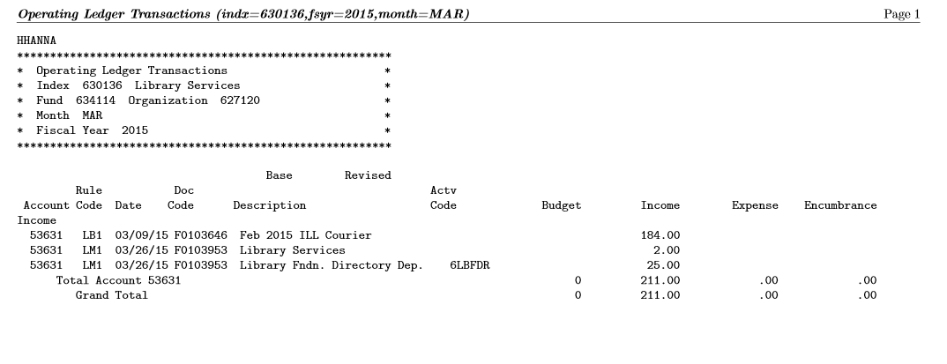
Operating Ledger Transaction Report
This Banner report shows monthly transactions by Fund

Slide 19
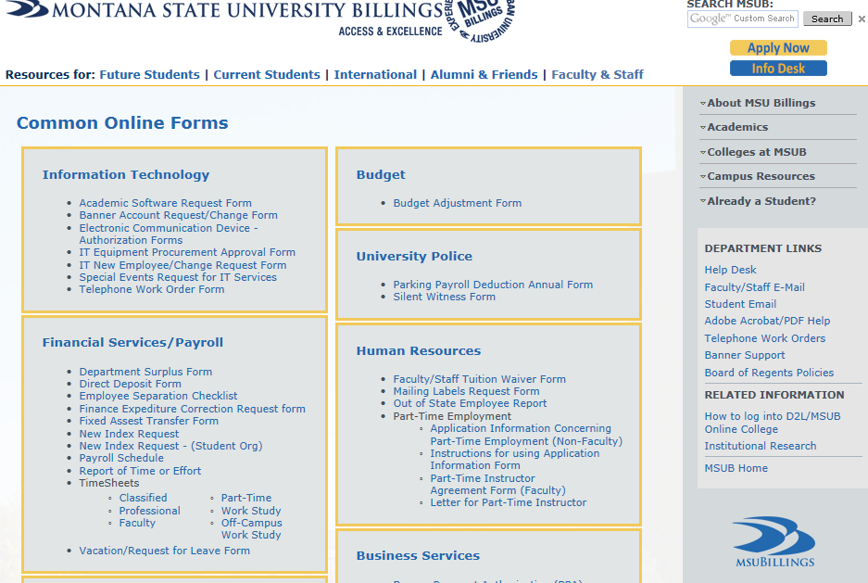
Requesting a New Index
To request a new index, complete a New Index Request form located on the Financial Services & Payroll page under “Forms.”
To request a new index for Student Organizations, complete a New Index Request (Student Org Only) form located on the Financial Services & Payroll page under “Forms.”
Both of these forms are also located under Faculty/Staff page under the Financial Services/Payroll forms.

Slide 20
General Ledger
Shows Fund balance as of a point in time
Includes cash balance
General Ledger balances change as amounts post to Operating Ledger
Also referred to as the Balance Sheet
Find General Ledger activity in Banner in the FGITBSR form for Restricted (62xxxx), Designated (63xxxx) and Auxiliary (64xxxx) Funds

Slide 21
FUND
Shows ownership of cash or fund balance.

Slide 22
Types of Funds
Type Fund No. Description
General Operating 61xxxx Appropriation
Restricted 62xxxx **Usually Grants & Contracts**
Designated 63xxxx Revenue Earning
Auxiliary 64xxxx Revenue Earning

Slide 23
Types of Funds (cont.)
General Operating Funds (begin with 61xxxx)
Money is state appropriated
No revenue can be recorded in these funds
The indexes are given a budget by the Budget Office
Funds that remain unspent as of the end of the fiscal year revert to the State of Montana and cannot be carried forward to be spent in the following year

Slide 24
Types of Funds (cont.)
Restricted Funds (begin with 62xxxx)
These funds are externally restricted by some entity other than the university
Grants and contracts and financial aid are included in this group

Slide 25
Types of Funds (cont.)
Designated Funds (begin with 63xxxx)
These are self-supporting accounts such as recharge centers, revenues and expenses related to fees, or special organized activities of educational departments
In order to be classify as a designated fund, all of the following conditions must be met:
The activity must be self-supporting
Expenditures can only be made in support of that activity
Budget support for that activity must not be available from other current funds
Excess funds are normally not generated
Unspent balances are carried forward to the next year

Slide 26
Types of Funds (cont.)
Auxiliary Funds (begin with 64xxxx)
These funds are self-supporting and used to account for auxiliary operations devoted to providing essential on-campus services to students, faculty or staff
Examples include residence halls, parking lots and Bookstore
Income is derived from user fees
Unspent balances are carried forward to the next year

Slide 27
How do I find my Fund Balance?
There are a few different ways to find Fund Balance in Banner:
FGITBSR form in Banner shows General Ledger activity or:
General Ledger report on the Banner Report Web
Banner Report Web link: https://sais.montana.edu/cgi-bin/msu_sb_v3.pl

Slide 28
General Ledger activity in FGITBSR
Query on Fiscal Year in Banner back to ‘00
Use Fund number instead of Index number
Revenue and Expense Control accounts show the YTD revenue and expense for fiscal year
The current Fund Balance is $3,888.46
**Please note if the revenue and expense control account to not match your Index revenue and expense totals, there may be more than one Index associated with the Fund.

Slide 29
General Ledger Report
The current Fund Balance is $3,888.46

Slide 30
Questions on setting up a new index or chart-related items?
Heather Hanna 657-1682
General Fund, Designated, Auxiliaries and Plant indexes
Brenda Brakke 657-1679
Grant, Designated, Agency and Student Club indexes

Slide 31
Operating
Ledger
Account
Codes

Slide 32
Operating Ledger Account
Operating Ledger Accounts are found in the Operating Ledger.
2 different items are represented by this field:
Revenue Accounts
Expenditure Accounts

Slide 33
Revenue Account Codes
Used to record money that the University receives from its activities in a given period. Sources of revenue include appropriations, fees, and the sales of products and/or services to customers.
Revenue codes are five or six digits in length
Lead digit will be 5

Slide 34
Revenue Account Codes (cont.)
In general, if money is being brought over from the Foundation, it should be recorded in account 53950 – Misc. restricted gifts
An exception to this would be if money is deposited into a General Fund index (index beginning with 61xxxx), then an abatement (or reduction) of expense would occur

Slide 35
Expense Account Codes
Used to identify an outflow of money to pay for an item or service or an activity that is accounted for as an expenditure (expense)/deduction or transfer-out
Expense codes are five or six digits in length
Lead digit will be 6
61xxx – Salary and benefits (Do not use when coding BPA’s)
62xxx – Operating expense
63xxx – Capital equipment

Slide 36
Operating Expense
Operating expenses start with a 62xxx and are broken down into the following categories:
621xx – Contracted Services
622xx – Supplies
623xx – Communications
624xx – Travel
625xx – Rent
626xx – Utilities
627xx – Repairs & Maintenance
628xx – Other

Slide 37
Operating Ledger Account Code List
A revenue and expense Account Code List can be found on the Business Services webpage:
http://www.msubillings.edu/boffice/acctspayable.html

Slide 38
Operating Expense vs. Capital
Capital equipment – use account code 63xxx
Individual piece of equipment
Cost is over $5,000 (including ancillary costs, i.e. freight, transportation costs, site preparation costs, etc.)
Non-capital equipment – use account code 622xx
Equipment costing less than $5,000 (including ancillary costs, i.e. freight, transportation costs, site preparation costs, etc.)

Slide 39
Rules of Thumb
BPA’s should not be coded to account codes beginning with 61xxx (payroll expense)
Revenue accounts should not be used for General Fund indexes (indexes beginning with 61xxxx)
Try to use a specific account code in the appropriate category rather than using a “General” account code (i.e. 6xx99 acct.)
If “abating” (or reducing) an expense, use the same index and expense account for the reimbursement

Slide 40
Finance Corrections
If you have a correction, please complete a Finance Expenditure Correction request form (located under Forms on MSUB Faculty/Staff page)
This form is for transactions that have processed and posted in Banner
All corrections need Fund Controller approval

Slide 41
Finance Correction Examples
Reasons to use the Finance Expenditure Correction form:
Change/Correct Index
Incorrect index was used and need to correct
Index and/or fund does not have sufficient funds to cover expense and therefore expense needs to be moved to another appropriate index
Change/Correct Account Code
Incorrect account code was used and need to correct

Slide 42
Finance Expenditure Correction Form

Slide 43
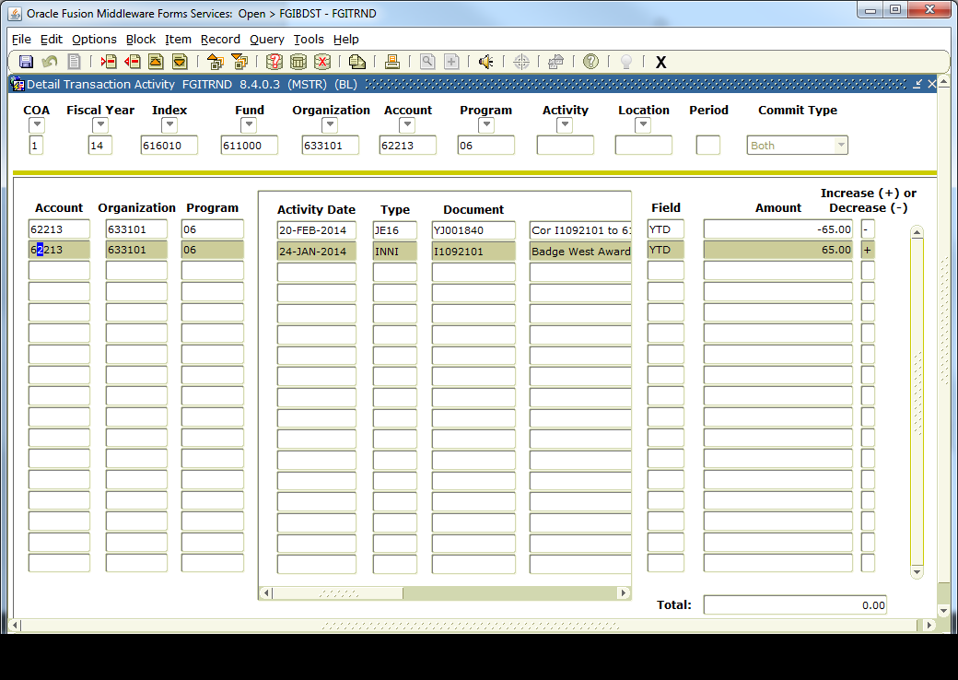
Finance Expenditure Correction Form (cont.)
Please attach backup documentation:
EXAMPLES:
Banner screen shot of transaction to be moved:

Slide 44
Finance Expenditure Correction Form (cont.)
Copy of Banner transaction report, identifying which transaction(s) to be moved
Copy of Business Purchase Authorization (BPA)

Slide 45
Questions on Account Codes?
Financial Services
Heather Hanna Financial Manager x1682
Gina Herbert Accountant x2625
Brenda Brakke Grants Manager x1679
Business Office
Tami Eller Accounts Payable x1706
JoAnn Rhodes Accounts Payable x1683
If you have any suggestions for future Financial Services training, please contact Heather Hanna at 657-1682 or email heather.hanna@msubillings.edu

