Slide 1
Powwow Volunteer Position Descriptions
49th Annual MSUB Powwow:
Blessing the Heartbeat
April 7th and 8th, 2017
Alterowitz Gym

Slide 2
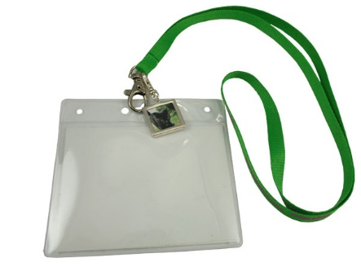
Volunteers Check In
All Volunteers will sign a Risk and Liability Form.
All Volunteers will receive a lanyard with their name tag and emergency numbers.
A report to faculty members is provided by the American Indian Outreach office for those who are working the Powwow for credit in a college course.
All Volunteers will complete an evaluation of their experience.
All Volunteers are expected to sign out at the end of their volunteer shifts. Return the lanyard.

Slide 3
MOVERS!
Meet at LA 210 at 11:30 a.m. on Friday, April 7th to help load supplies and move them to the gym to unload.
We will have dolly’s, hand trucks, and carts to help facilitate the move.
We need energetic people.
If you have a vehicle with packing space, we NEED YOU!
It usually takes 3 pickups and 3 SUV’s to move all the equipment
Volunteers with vehicles are permitted to drive onto campus from Normal Avenue on the north sidewalk to the Liberal Arts Building.
We use the west facing door that enters the Art Department as our loading zone.

Slide 4
Signage Team
This team (of two per team) puts up large signs on doors and walls in the gym. Gaffer’s tape is provided for this task. The areas for signage include:
Registration
Elder Area
Grandparents with children
Mobility Reserved Area
Dressing Room
T-shirt Sales
Volunteer Check-in

Slide 5
Computer Set Up
The Announcer’s table will need the following equipment set up:
Two laptops – Internet access is not required.
One printer/copier
Extension cords and surge protectors are provided.

Slide 6
Camera Operators
The Powwow will be filmed through a live feed video on the MSUB website for 2-hours on each day of the powwow. Camera operators need to follow the main action of the Powwow, with occasional focus on individuals, drum groups, specific dancers, head staff, Announcer, elders, etc… While operating the camera, your voice will be picked up by the microphone. BE CAREFUL WHAT YOU SAY!
Assigned volunteers may sit with the camera operator and narrate activity being filmed. Such as describing what dance is being performed, information about the champion dancers, storytelling about the dance being performed, the history of the dance and powwows. Commentary about the learning process, preparing outfits, getting ready for a powwow, etc…
The Powwow Committee may choose elders, alumni, and MSUB administrators/faculty/staff to also narrate the powwow filming with innovative commentary they might wish to provide.
Training will be provided by the Athletics Department personnel prior to the Powwow on Friday afternoon about 4:00 p.m.
The cameras can never be left unattended. At the end of the filming session, contact the building manager to disassemble the equipment and put it back in proper storage.

Slide 7
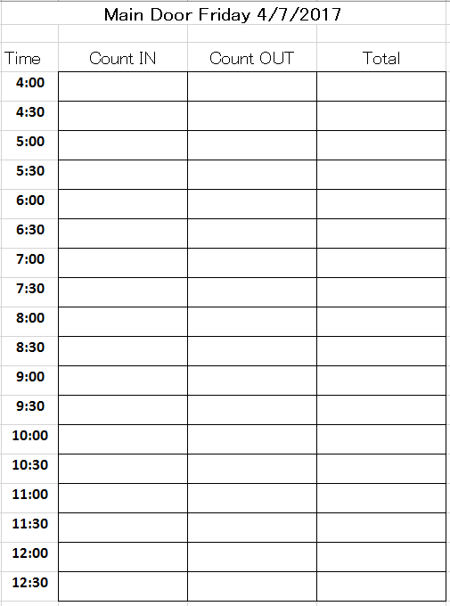
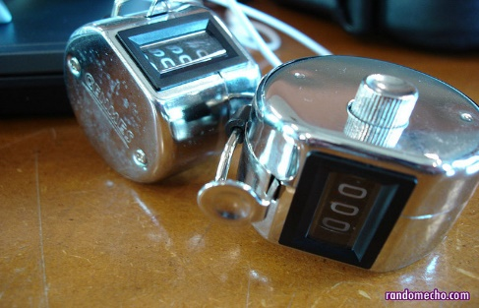
Door Counters
2 persons at the entrance doors to the gym foyer clicks the counter for each person that enters the building.
2 persons at the exit doors to the gym floyer clicks the counter for each person that leaves the building.
2 persons at the tunnel level with one counting those who come in the building and another to count those who go out.
The purpose is to determine if the audience is close to reaching the building maximum capacity of 2,500.
Conduct a capacity measure every 30 minutes by the following procedure:
The exit number is subtracted from the entrance number to determine how many people are actually in the building.
Use the forms provided to track the size of the audience at each time indicated.
When 2,000 number is reached. Inform your contact at the Volunteer Check-In table in the gym foyer.
When 2,200 number is reached. Inform Reno.
When 2,400 number is reached. Inform Security and stop allowing people to enter the building unless the same number is exiting the building. For example, two can enter the building if two are also exiting.

Slide 8
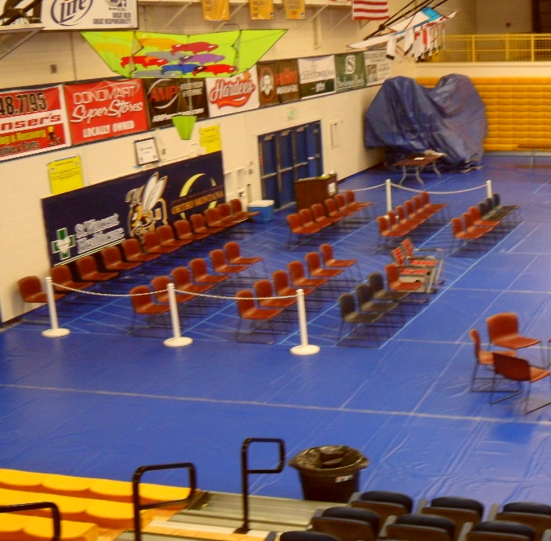
Elder VIP Area
The area will be roped off to control access. Inform elders that only one care giver is welcome to join them. For example, an elder and a family of 8 would exceed the purpose of the reserved area for elders. Advise grandparents with grandchildren of the reserved area in the bleachers on the south side of the gym. Likewise, there will be a reserved area for mobility empowered persons, such as wheelchairs and baby strollers. Seek assistance from an Event Security person if needed.
Showing respect and honoring the elders is your responsibility. Please help keep the area clean and safe to ensure the elders have a great experience. If you see an elder struggling with their chairs and belongings, step up and give them a helping hand.
The Elder VIP Supervisors will determine the schedule of gift giving. The gifts will be boxed and labeled for distribution on Friday and Saturday. In the meantime, offer each elder a cold bottle of water, hard candy, and a tissue. Offer to assist elders by getting items they would like from the concession stand. Always count out the money before you leave and count out their change when you give them their purchases. Ask the elders if they are aware of the restroom locations. Be cheerful about why we have wide aisles in the Elder’s reserved area. Dancers will come through on Saturday to shake hands with the Elders.

Slide 9
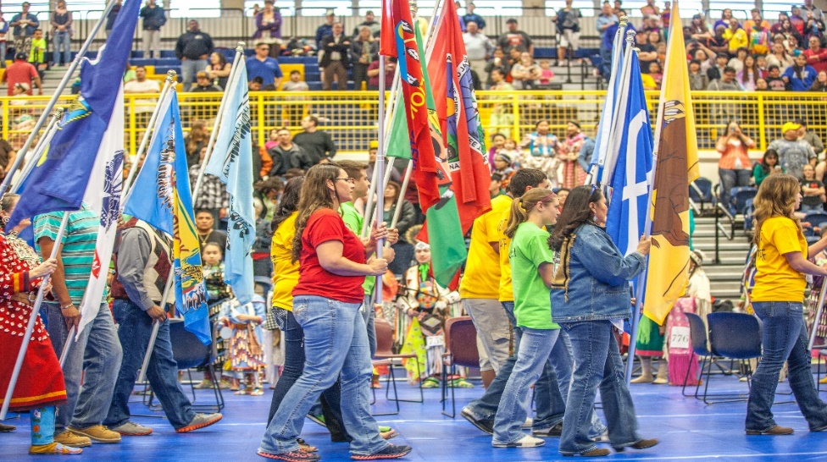
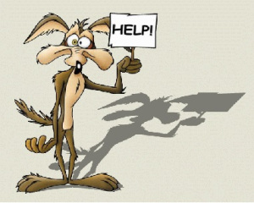
Grand Entry Line Up
A list of the Grand Entry line up order will be provided for you. Check in with Reno Charette at the Announcer’s table to collect the forms and tools you’ll need for Grand Entry.
Collaborate with the Arena Director, as minor changes to the order might occur.
Collect names and titles as indicated on the forms. Please include phonetic spellings to help the Announcer.
Turn in the completed list to the lead Announcer.
After the color guard and all the flag carriers have entered the dance circle, the dancers will come in.
Hold up the signs for each dance category in the numerical order written on the back of each sign. The signs should be in order when you receive them.
Write down the numbers of all the dancers as they pass through the entry point. The dancers want their numbers accounted for. They will show you their number as they pass. For the most part, the dancers will enter in categories by the type of contest they are in. For example, Men’s Traditional, Men’s Grass, and Men’s Fancy will enter in that order.

Slide 10
Security
Supervisors will set up rotations among the security crew members to visit each of the following check points:
Entry Doors:
Check on each person working as a door counter to assist them in dealing with intoxicated persons. Inform them the event is drug and alcohol free and ask anyone who appears to be intoxicated to leave.
Call a University Police officer if you need assistance. Cell phone numbers are on the lanyards.
Lower Gym:
Check each of the three stairwells,
Men’s locker room – (Send a male volunteer), check the pool door;
Women’s locker room – (Send a female volunteer), check the pool door;
and all hallways in the lower gym area. No children, teen, or wandering adults should be hanging out in the lower gym hallways.
Check the pool doors; PE52 – Classroom;
Main Gym:
Upper and Lower bleacher areas. Make sure all access aisles are clear and children are not running up and down the aisles.
Check the Drummer’s areas. Take note of excessive garbage, walk through with garbage bags and ask the drummers to clean up their area. Provide garbage bags that will be available in the Hospitality Room.
Check in at the Announcer’s table to see if any problems have been reported or if any action is requested by the Announcer or Arena Director.
At the start of each day, have a security person direct the audience to seating in the bleachers. Only the drummers will be seated on the floor. If this situation escalates to conflict then call for a University Police officer.

Slide 11
Security Outside the Building
Never go alone. Form teams of two or three.
Wear a reflective vest and take a flash light for outdoor patrols around the building, softball field, softball dugouts, tunnel, parking lot, parking garage.

Slide 12
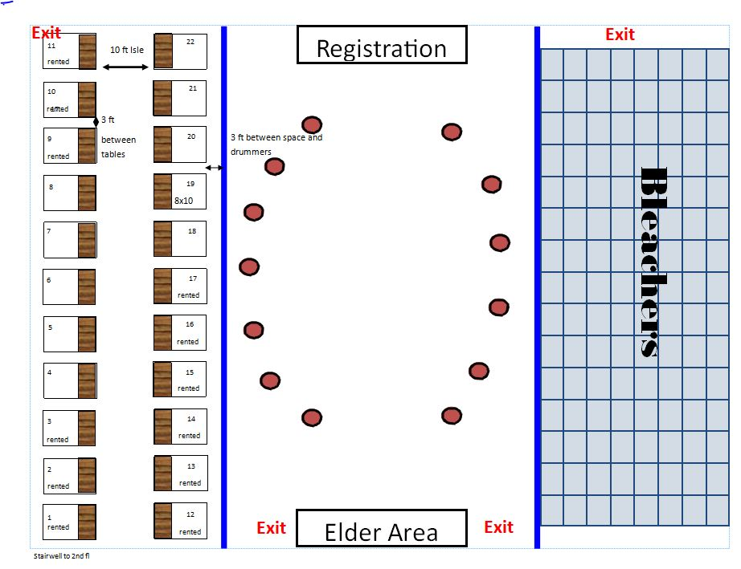
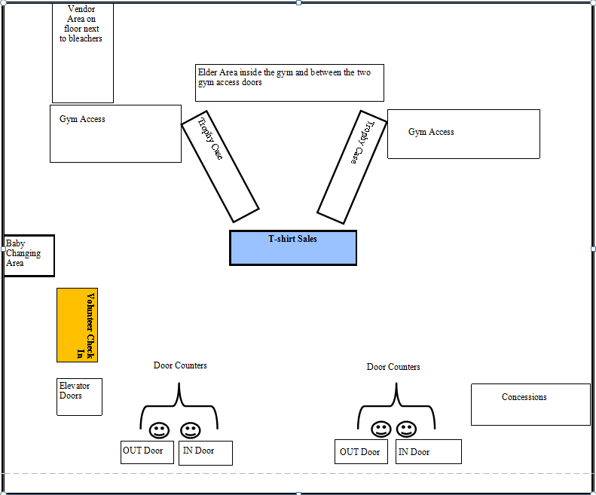
Table Stackers
26 tables will be stacked at the northeast corner of the gym.
See the floor plan layout for the Vendor Area, Hospitality Room, and Foyer for instructions on where to set up the tables.
Saturday Cleanup crew will drop the tables and restack at the northeast corner for pick up.
See floor plans

Slide 13
Sales
Tee Shirt Sales:
Set up sales table to display shirts with prices. Organize the stock for easy accessibility by size and label. Set up the cashier’s box with all money sorted and accounted for. You should have $50.00 as starting change.
Prices: Tee shirts – Small to 2XL are $15.00, Larger shirts are $20.00.
Designate a sales volunteer to walk through the crowd with a display shirt and sell shirts in the bleachers.
50/50:
Each ticket is $1.00 for one, or $5.00 for 6, or $_(TBA)_______ for an arms length.
Sales people need to set up a rotation schedule of walking through each set of bleachers to sell tickets every hour. There will be two upper sets of bleachers and one lower. The Basketball audience, Drummers and Vendors are also potential customers. This is the ideal job for cheerful volunteers that enjoy meeting people and are comfortable approaching the general audience.
$15

Slide 14
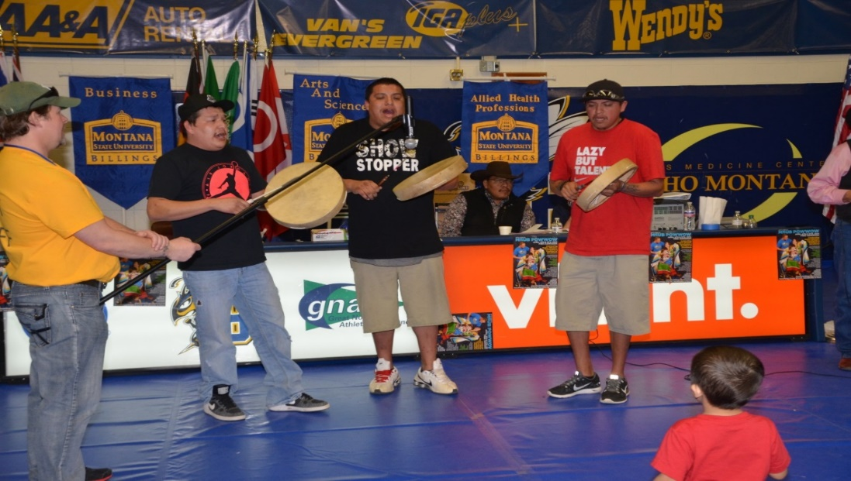
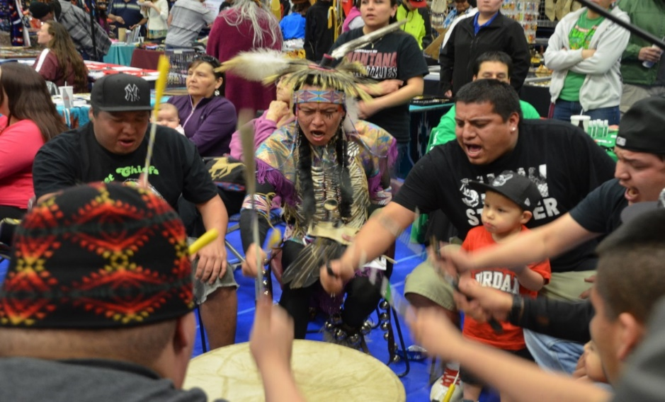
MIC CARRIER FOR DRUM GROUPS
Get up close and personal with the drums and singers.
The Arena Director will let you know which drum is next. Staying in tune with the Arena Director makes this job easy and fun. The Mic is attached to a wheel base and is easily moved from one drum to the next. Report to the Sound System vendor at the Announcers table when new batteries are needed. Ear plugs are provided for those who prefer them.

Slide 15
Hospitality Room
The Hospitality Room Manager is responsible for maintaining a clean and safe environment for the volunteers. It’s a break room. The Hospitality Room Manager keeps the coffee and tea pots going, organizes treats for the volunteers, puts cold food and water on ice, restocks ice daily in the ice chests located at the Elder VIP and Announcer’s table. The Manager contacts the custodians for regular pick up of trash so the room is clean for the hard working volunteers.
The Hospitality Room Manager organizes the gifts needed for the powwow in a fashion that matches the order of giving on the powwow agenda. The Manager also monitors the Study Hall across the hall. The Study Hall is for students and must be a quiet place. The Hospitality Room is the place for visiting and laughter. The Hospitality Room is for volunteers and powwow Head Staff only. No children.

Slide 16
APPRECIATION
All Volunteers keep their event t-shirt.
All Volunteers will receive a certificate of appreciation.
All Volunteers will receive a letter of recommendation.
All Volunteers will be exposed to an authentic cultural experience

Slide 17
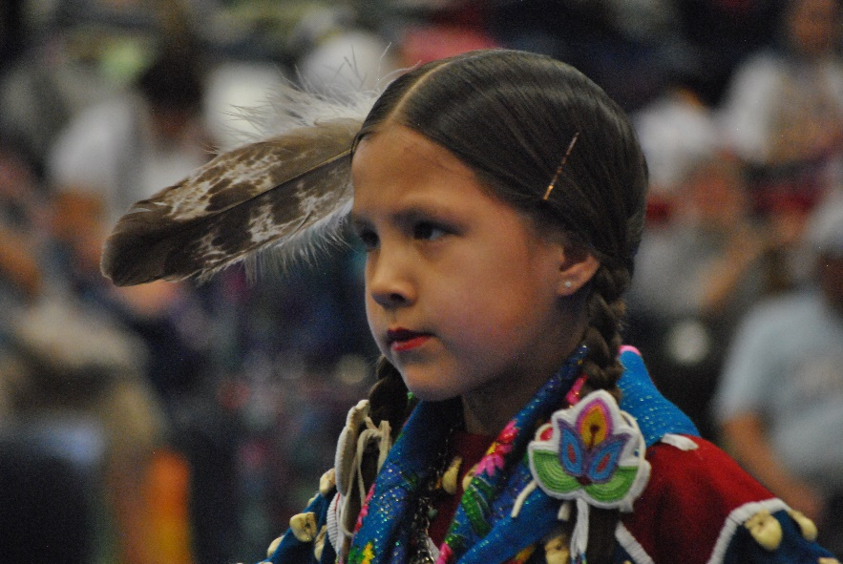
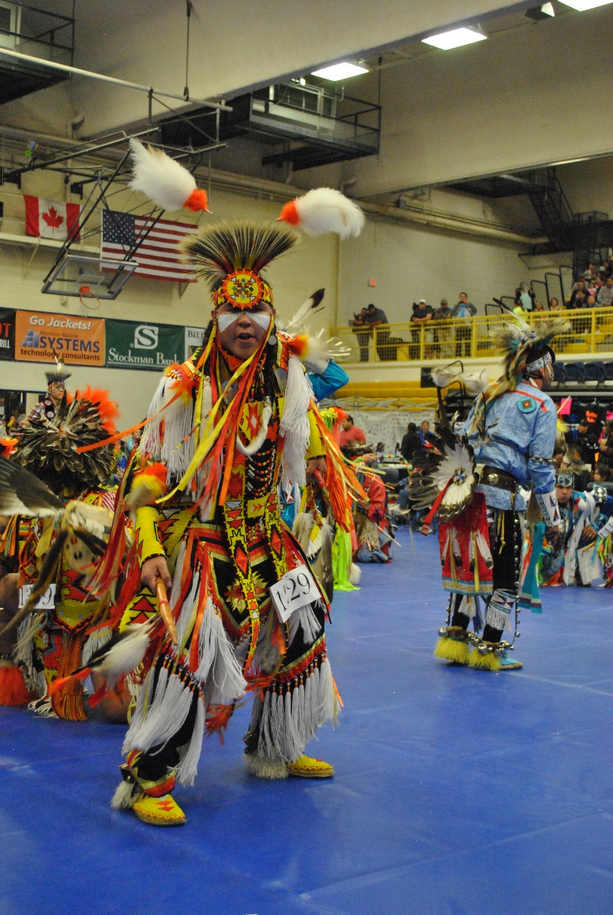
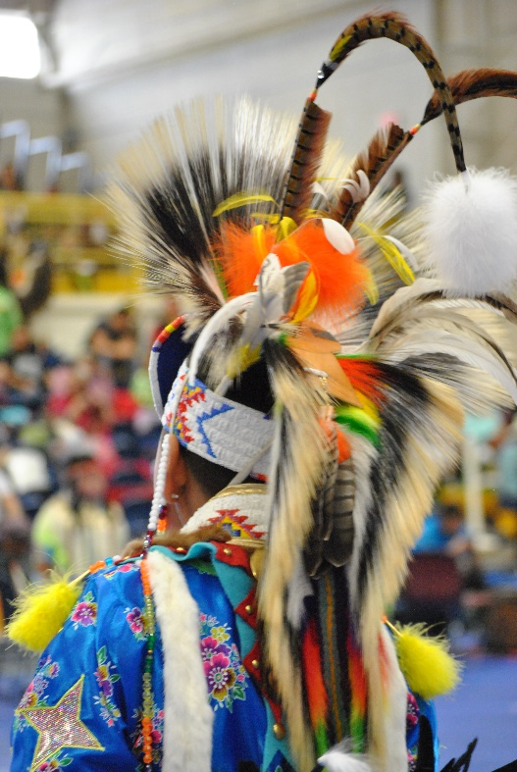
Aho!

