Slide 1
EDU 397F
Questioning Strategies

Slide 2
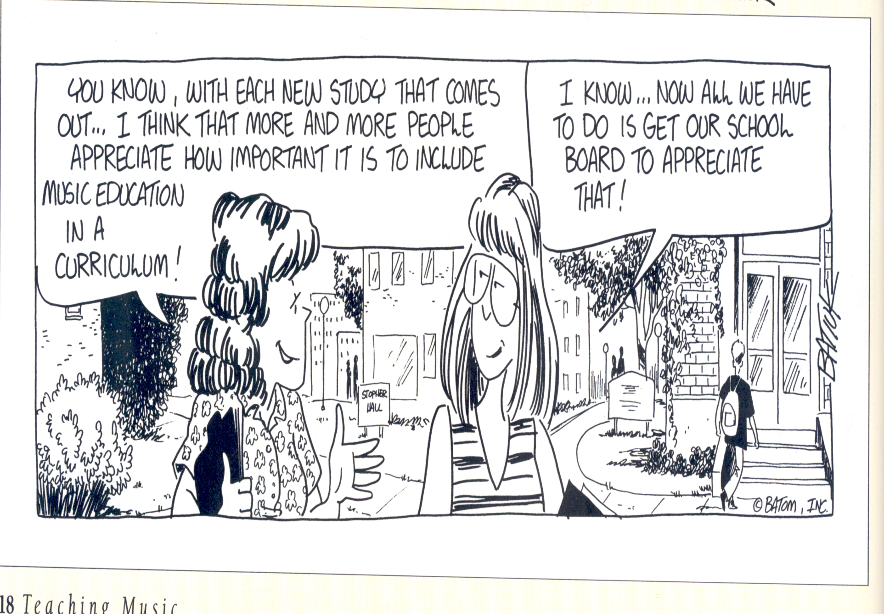

Slide 3
Questioning Strategies
Objectives:
TSW understand key signatures with flats as evidenced by a music skills practice sheet and music skills assess.
TSW learn half notes (ta-a) (Kodaly) as evidenced by rhythmic composition assignments
C.M. – Names in gradebook
Orders for Recorders ($4 each; try to have correct change)
Questioning Strategies
M.D. - Do
Basal Series
Music Ace
Key Signatures – flats (second to the last flat)
Keyboards (SONG)
Grant Proposal Questions
For Tuesday: Write 4 MD measures starting and ending on Do, work on grant proposal and microteaching lessons.

Slide 4
Questioning Strategies
Blooms Taxonomy (1956)
Knowledge
Comprehension
Application
Analysis
Synthesis
Evaluation
Anderson & Krathwohl (2001)
Remember
Understand
Apply
Analyze
Evaluate
Create

Slide 5
Find your music Passion creates the deepest learning!

