Slide 1
Using MyInfo

Slide 2
Use MyInfo To Access:
Student records
Degree works
Financial aid
Employee services
Parking services

Slide 3
1. Access MSUB’s Homepage
www.msubillings.edu

Slide 4
2. Hit the ‘MyInfo’ tab

Slide 5
3. Click on Log in to MyInfo (NetID)

Slide 6
4. Log in using your NetID and the password associated with it

Slide 7
Tabs in MyInfo
Where they are and what they mean

Slide 8
The Personal Information Tab
Update your address, ethnicity, and contact information
IMPORTANT: FAFSA documents and checks, billing statements, academic notices, etc. will not reach you if your address and contact information are not current

Slide 9
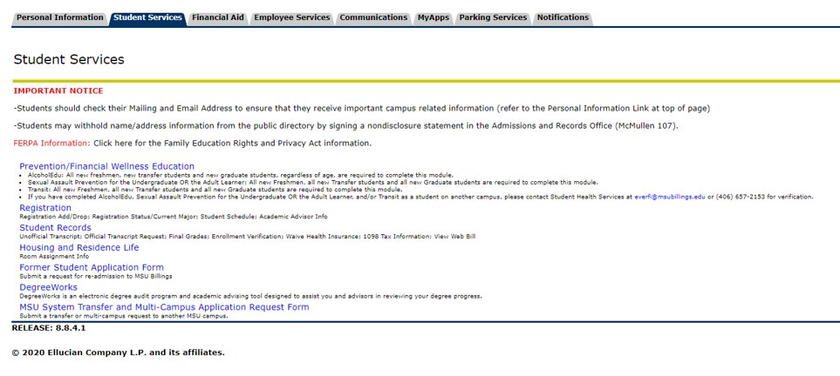
The Student Services Tab
Register for classes, drop classes, access your transcripts, check/print schedule, apply for re-admission, DegreeWorks

Slide 10
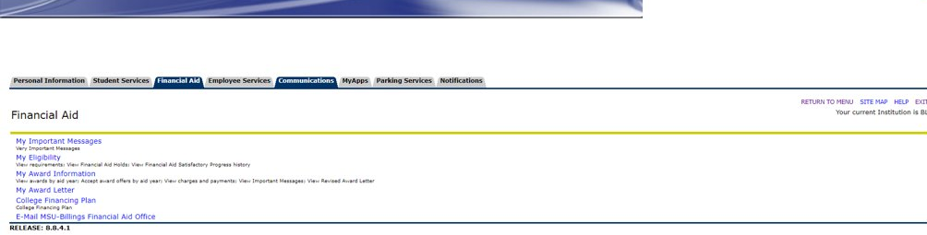
The Financial Aid Tab
View the status of impending FAFSA funds, determine eligibility, accept or decline offers, view college financing plan

Slide 11
The Employee Services Tab
Update time sheet, view benefits, update your direct deposit, view paystubs and tax forms
*for students who hold jobs with the university*

Slide 12
The Parking Services Tab
Purchase parking passes, pay/appeal a citation, update vehicle information
IMPORTANT: receiving a parking ticket can result in a hold, which can be placed on the release of a student’s transcript or delay graduation if unpaid

Slide 13
The Notifications Tab
Access notifications sent by the university

