Slide 1
Yellowjacket Experience
Understanding Opportunities and Services at MSUB

Slide 2
Yellowjacket Experience
Academic Success

Slide 3
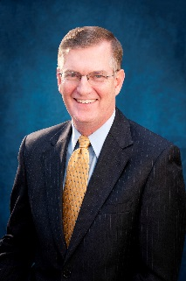
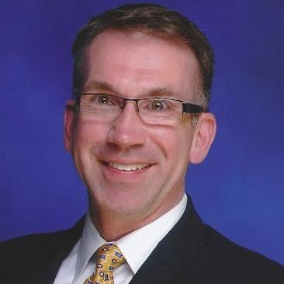
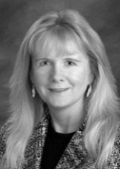
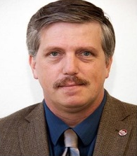
University Structure
Chancellor –
Dr. Mark Nook
(A.K.A. Fearless Leader)
Student Affairs
Administrative Affairs
Vice- Chancellor:
Dr. Joe Oravecz
Academic Affairs
Vice- Chancellor:
Terrie Iverson
Vice- Chancellor:
Dr. Bob Hoar

Slide 4
University Structure
Chancellor –
Dr. Mark Nook
(A.K.A. Fearless Leader)
Administrative Affairs
Student Affairs
Enrollment Services
Auxiliary Operations
Community Involvement
SSS/Trio
University Police
Budget Office
Facilities
Human Resources
Business Services
Academic Affairs
Deans
Faculty
International Studies
Academic Success Center
Library
Vice- Chancellor:
Dr. Joe Oravecz
Vice- Chancellor:
Terrie Iverson
Vice- Chancellor:
Dr. Bob Hoar

Slide 5
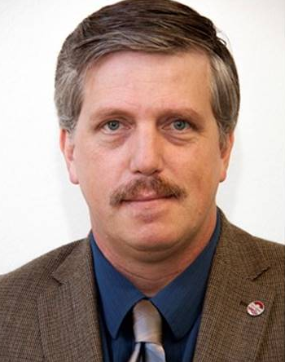
Academic Affairs Structure
College of Arts & Sciences
College of Business
College of Allied Health
College of Education
City College
Vice-Chancellor:
Dr. Bob Hoar

Slide 6
Academic Affairs: Classroom Expectations
What do you think are some expectations your students will encounter in the classroom?

Slide 7
Classroom Environment & Structure Differences From High School
Size
Meeting times
Format – Lecture vs. discussion
Tests & Grading
Note taking

Slide 8
Instructor Expectations
Background knowledge and skills
Generating questions
Class material
Systems of organization for assignments, notes, and handouts (notebooks/folders).
Student focused vs. content focused

Slide 9
Teacher Supported Vs. Student Directed
Student Directed:
Students are in charge of their learning.
Manage assignments, behavior, choices, time, grades.
Self-Advocate

Slide 10
Last Year’s Freshmen Advice:
Go to class!
College is not like high school – it’s harder.
Expect and plan for it.
Figure out how to manage your time.

Slide 11
Note for Parents
Contacting Instructors
Grades
Let Your Student Be A Self Advocate

Slide 12
Students Affairs: Support for Academic Success
A&SC 111 – First Year Seminar
Library
Student Success Services
Disability Support Services
Advising & Career Center
Academic Success Center
Developmental Ed Coursework

Slide 13
How is your student placed in math, writing, and reading courses?
COMPASS Placement Exam
ACT/SAT scores
MUS Writing Score
Prior learning credits
Example: College Level Examination Program (CLEP), Advanced Placement (AP), and Defense Activity for Non-traditional Education Support (DANTES)
Transfer credits / Dual credit courses
Notes:
There are a few things that advisors look at before advising you on which math and writing courses to take. Your Compass placement scores, ACT, SAT, and/or MUS Writing scores will all be taken into account when being placed into math and writing courses. If you have prior learning credits, such as AP or transfer credits, you will need to let your advisor know.

Slide 14
Placement Options
College Level
100 and above level courses.
Courses go into GPA calculation and credits earned toward graduation.
Developmental Education Courses
Below 100 level courses.
Will not receive college credit for these courses and grade does not count toward GPA.
Courses that “bridge the gap” between current knowledge and knowledge needed to be successful in future courses.

Slide 15
Most Common Freshmen Errors
• Not going to class.
• Not paying attention in class (sleeping, talking, etc).
• Going home after class instead of spending time on campus.
• Expecting to do the same amount of homework as in high school.
• Working too many hours while going to school.
• Taking too many credit hours.
• Not spending enough time studying.
• Not studying until just before an exam.
• Doing all studying by themselves.
• Coming to lecture unprepared.
• Not making the effort to talk personally with professors.
• Rushing through homework just to get it done, not using it to learn.
• Not taking notes, or taking incomplete or illegible notes during lectures.

Slide 16
Yellowjacket Experience:
Parent Partnership

Slide 17
Partnership Is Power
“Economists report that a college education adds many thousands of dollars to a person’s lifetime income–which they then spend sending their child to college.”
Bill Vaughan

Slide 18
Rights and Responsibilities
College is a PRIVILEGE and comes with RESPONSIBILITIES
MSUB provides each student the opportunity to learn by creating freedoms and rights of students
Freedom of inquiry, speech, and assembly
Freedom of threats, acts of violence and obscenity
Right to study and learn in an place of academic freedom
Right to due process in University misconduct action
Etc.

Slide 19
Rights and Responsibilities
Each student has the responsibility:
To respects the rights and property of others
Fully acquaint and comply with University rules
To comply with local, state and federal laws
Recognize that individuals reflect upon the University
Adhere to academic requirements by instructors

Slide 20
University Misconduct Process
Students are stewards and representatives of the university and held to Student Code of Conduct
MSUB will hold students accountable for misconduct, along with state, local, federal laws
Education Vs. Enforcement
MSUB is committed to the development of your student if they are committed to themselves
Example: Alcohol Situation Resulting in Insight
Academic integrity is also the responsibility of the student
Cheating, plagiarism, false citations, etc.

Slide 21
University Misconduct Process
When a report of misconduct is received:
Student is notified and instructed to meet with University Hearing Officer in a timely manner
Administrative Meeting with student takes place to learn about the person and the incident
Three sides to every story…
If student is found responsible for violations then held accountable through educational interventions and/or probation
Student conduct stays with student during college
Totality of a student’s character is impacted

Slide 22
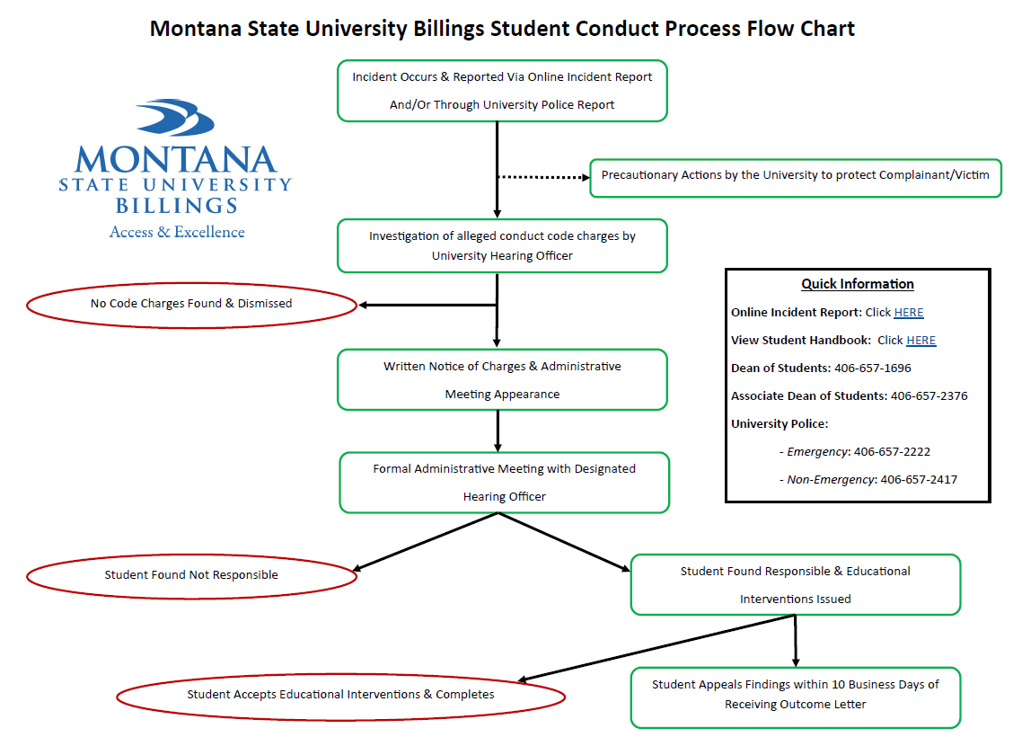

Slide 23
Clery Act
Enacted in 1990 after the death of Jeanne Clery (19) in 1986
Assaulted and murdered by another student on campus after room was left unlocked
Previous situations had not been reported to the campus in a timely manner
Requires all federally funded colleges to keep and disclose campus crime information
Annual Campus Security Report due by Oct. 1
Includes major crimes and fire situations
Reports are kept for seven years and published emphatically

Slide 24
Sexual Assault Resources and Awareness
There is a lot going on at some universities in Montana…Let’s talk about how we are providing proactive education for your student.
Developing a campus culture of awareness and prevention
Awareness programming and education and sharing of resources beginning at orientation and continuing throughout the 1st year
Policies and procedures in place, as well as resources if something should happen
24/7 POST certified University Police officers
Title IX Coordinator and Sexual Assault Task Force
Highly qualified and trained student staff
Student Health Services
University Advocate Program
Collaboration with local resources & state Board of Regents policies

Slide 25
Alcohol & Sexual Violence Awareness
Our campus is committed to ensuring that you have a positive experience at MSUB. One way we can help is by providing more education about alcohol and sexual assault. Our goal is to show you how alcohol effects the mind and body, how this can impact academic success, and how you can reduce the harm associated with alcohol and sexual assault for yourself and your friends.
Alcohol Edu for College is an interactive, online program designed to inform students about how alcohol affects the mind, body, perceptions, and behaviors. It provides students with accurate, non-judgmental information and personalized feedback.
Haven is an interactive, online program created to address sexual assault, relationship violence, and stalking. It’s designed to engage and empower students to create safe, healthy campus environments.
The Montana University system is launching these programs system-wide this summer.
Our campus will contact you mid-summer regarding additional information on the programs, instructions, and deadline information. Parents will also be notified about the programs and MSUB’s completion requirements.

Slide 26
FERPA and Parent Notification
Family Education Right to Privacy Act
Affords student rights with respect to educational records, limiting anyone out of college to access
Protects “educational records” including grades, transcripts, test scores, ID numbers, financial records, conduct records, and schedules
Does allow for Directory Information including information that is not considered harmful and an invasion of privacy
Why all the secrecy?
Legal constraints in place
Supporting student development making transition to adulthood and providing rights and responsibilities
Notes:
Name, local and permanent addresses, local and permanent telephone numbers, e-mail address, date and place of birth, dates of attendance, class, college, major, most recent school attended, full-time or part-time status, honor roll, participation in officially recognized activities and sports, weight and height of members of athletic teams, degree(s) and honors conferred, and commencement program information

Slide 27
FERPA and Parent Notification
We know you play an active role including:
Emotional support
Financial support
Reinforcing good behavior and habits
Students are encouraged to share information and include you key decisions and situations
Talk with your student about the kind of information you should be allowed to see
FERPA Waiver exists to support you and your student

Slide 28
Enhancing The Yellowjacket Experience

Slide 29
Enhancing the Yellowjacket Experience
Involved students = Successful students
Research Says…….
Students learn more the more they are involved in both the academic and social aspects of the collegiate experience. An involved student is one who devotes considerable energy to academics, spends much time on campus, participates actively in student organizations and activities, and interacts often with faculty.
The quality and quantity of the student's involvement will influence the amount of student learning and development.
~Alexander Astin

Slide 30
Enhancing the Yellowjacket Experience
Hours in a Week = 168 hours (Monday-Sunday)
Classroom time: 5 classes = 15 hours/week
Study Time = 20 hours/week
Sleep = 49 hours/week (avg. 7/night) Total: 84
168 hours – 84 hours = 84 hours/week remaining
How is it spent?

Slide 31
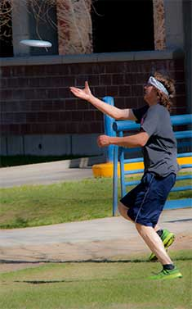
Enhancing the Yellowjacket Experience
Why is Involvement Outside the Classroom Important?
Connection to the University
Opportunity to build skills, connections
Peer Relationships
Scholarship/Resume Material
Academic Success
Enhances the collegiate experience
Career Exploration/Enhancement
Valuable when applying for competitive programs

Slide 32
Enhancing the Yellowjacket Experience
Student Leadership
$ year leadership program
-Campus Involvement
-Community Involvement
-Mentoring Opportunities
-Community Connections
-Leadership Transcript

Slide 33
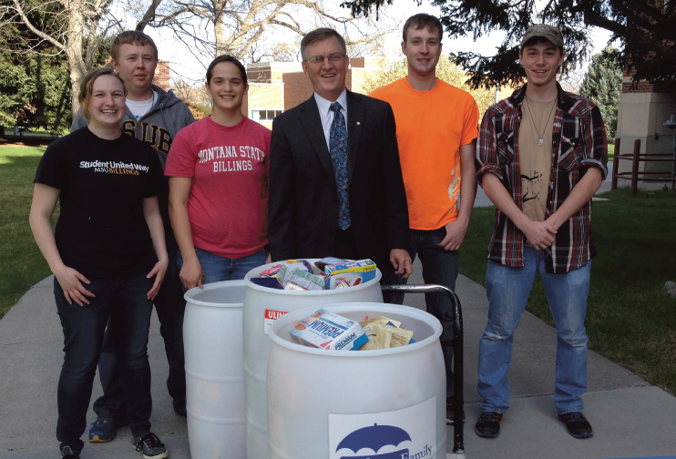
Enhancing the Yellowjacket Experience
Community Involvement
*Service Learning
*Student United Way
*Work Study Service Team
*Service Saturdays
….and many more volunteer opportunities
(MSUB Night on the Van, Blood Drives, Food Drives, etc)

Slide 34
Enhancing the Yellowjacket Experience
Intramural Sports
Athletics

Slide 35
Enhancing the Yellowjacket Experience
Student Organizations
Academic
Campus Media/Literary
Religious
Cultural
Government/Campus Programming
Honorary
Performing & Visual Arts
Special Interest

Slide 36
Enhancing the Yellowjacket Experience
The Arts:
Music
Art
Drama

Slide 37
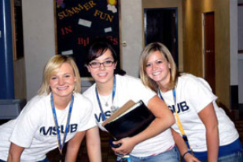
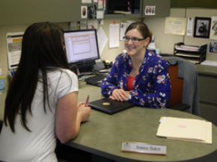
Enhancing the Yellowjacket Experience
Employment
Benefits:
Financial Assistance
Skill Development
Networking/Connections
Opportunities:
Work-Study
Part-Time Jobs
On campus
Off-Campus

